Slide 1




TASHKHISI
Medical & Healthcare Website
Graduation Project
2024-2025

Slide 2
Our Team
Mahmoud Ramadan Hegazzy 21-00923
Ganna Essam Mohamed 21-00717
Moaz Ismail Abdelmawla 21-01129
Fawzy Ayman Elsayed 21-00710
Doha Ahmed Gomaa 21-00603
Ragaiy Karam Ragaiy 21-01508
Mohamed Essam Mohamed 17-00329
Supervied By
Dr.Mahmoud Basiony Eng.Amany Emad

Slide 3
Abstract
Accurate and timely diagnosis is a cornerstone of effective healthcare, yet many individuals struggle to identify potential health issues based on their symptoms, especially without medical knowledge. The absence of early medical insight can lead to delayed treatment and increased risk of complications. Various factors, such as symptoms, age, and medical history, must be considered to achieve reliable diagnostic outcomes.
Tashkhisi addresses this challenge by offering an AI-powered medical web application that assists users in preliminary diagnosis and health education. The platform allows users to enter symptoms and demographic details to receive instant, data-driven diagnostic suggestions. It features secure user registration, personalized diagnostic history, and image-based disease detection capabilities.

Slide 4
Content outline
01
Introduction
06
Time Plane
02
Problem Statement
07
Current progress
03
Related Work
08
Conclusion
04
Methodology of Proposed Approach
09
Future Work
05
Research Objectives
10
References

Slide 5
Introduction
TASHKHISI project introduces a web-based healthcare platform designed to empower users to perform preliminary self-assessments of medical conditions with high accuracy and ease. Leveraging artificial intelligence (AI) and web technologies, the platform enables users to input symptoms and upload medical images, receiving informed feedback without requiring prior medical expertise. By integrating AI-driven symptom analysis and image processing, the system provides preliminary diagnoses, guides users toward appropriate medical specialties, and offers detailed, medically vetted information on conditions, symptoms, causes, diagnostics, and treatments. Built using the Flask framework and powered by a MySQL database, TASHKHISI combines the Priaid medical API with machine learning (ML) models to predict conditions such as diabetes, heart disease, liver disease, malaria, and fetal health. The platform aims to bridge the gap between individuals and healthcare systems, particularly in underserved regions, by promoting early detection, health education, and proactive healthcare behaviors, ultimately enhancing public health outcomes and quality of life.

Slide 6




Problem Statement
Difficulty in accessing reliable and timely medical consultations, especially for individuals in rural or low-resource areas.
Delayed diagnosis often leads to disease progression, complex treatments, and poorer health outcomes.
Many individuals rely on inaccurate or unverified online health information, resulting in misinformed and potentially harmful decisions.
Lack of simple and reliable digital tools that suit users with limited medical knowledge or health literacy.

Slide 7


Problem Statement (cont.)
Confusion about which type of medical specialist to consult based on symptoms, causing delays and frustration.
Limited access to timely medical advice due to overloaded healthcare systems and long waiting times.
Accessing medical consultations can be time-consuming.
Unavailability of clear, easy-to-understand medical information leaves users unsure about how to act when symptoms appear.

Slide 8
Related Work

Slide 9

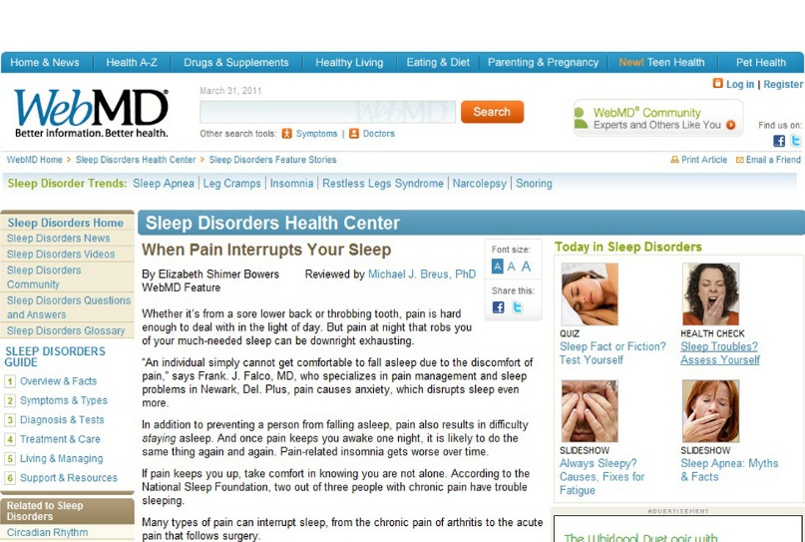
WebMD Symptom Checker [webmd.com]
Strengths:
Offers a broad medical knowledge base.
Widely used and easy to navigate.
Adds AI-powered medical image analysis alongside symptom input.
Provides a culturally relevant and accessible interface targeted at underserved regions.
Supports personalized user health tracking and history management.
Limitations Addressed by Tashkhisi:

Slide 10
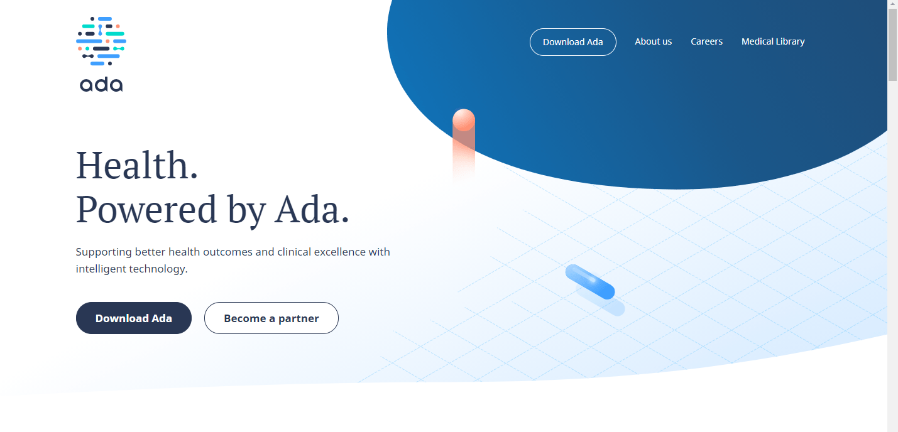
Ada Health [ada.com]
Strengths:
Advanced AI-driven symptom checker with high accuracy, especially for rare conditions.
Supports multimodal diagnosis combining symptom input and medical image analysis.
Incorporates user medical history for more personalized diagnostic feedback.
Offers improved contextual accuracy by leveraging demographic and historical data.
Limitations Addressed by Tashkhisi:

Slide 11
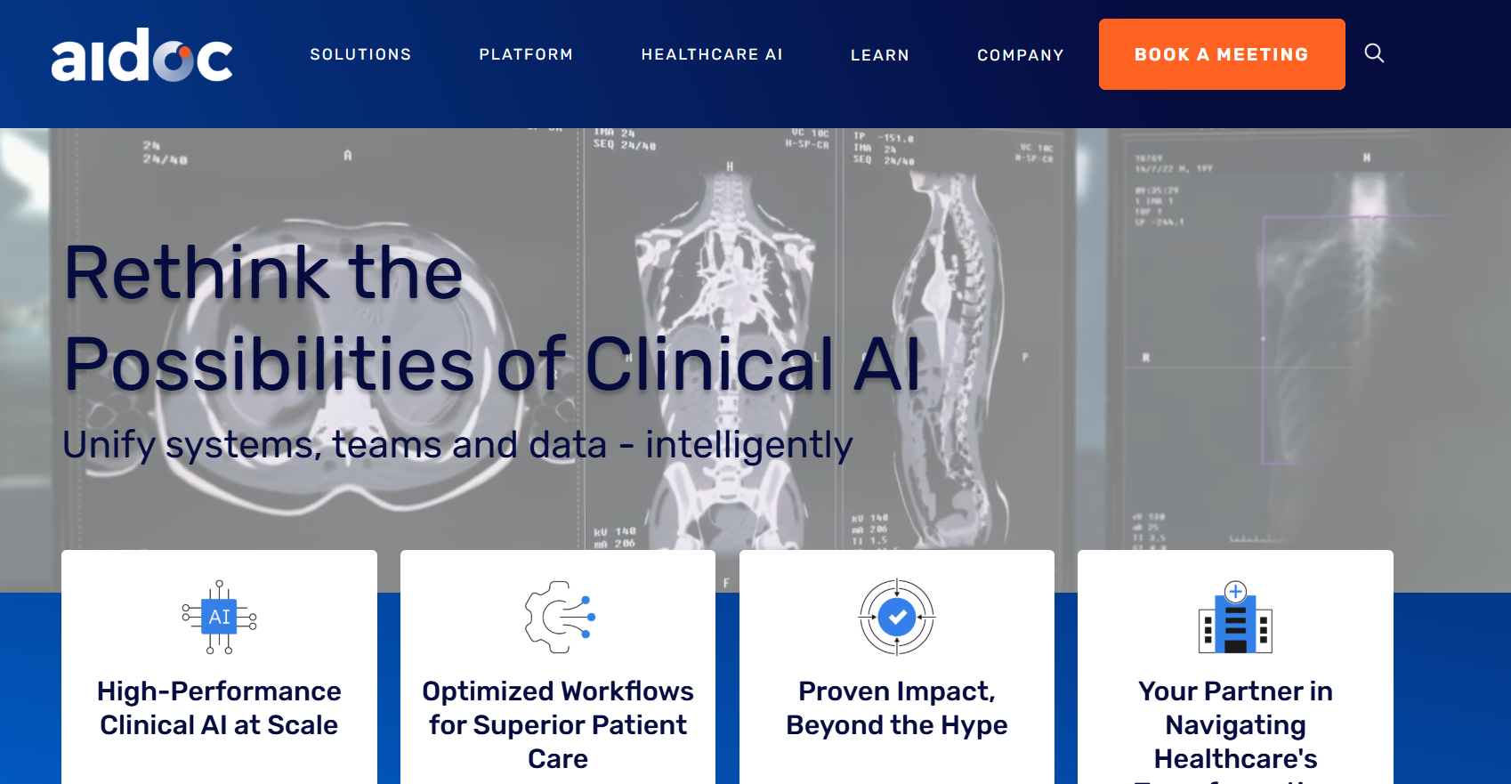
Aidoc [aidoc.com]
Strengths:
FDA- and CE-approved platform for real-time AI analysis of medical images in clinical settings.
Makes image-based diagnostics accessible to end-users, not just clinicians.
Integrates symptom analysis and image interpretation in one platform.
Enables ongoing tracking and user interaction, which Aidoc lacks.
Limitations Addressed by Tashkhisi:

Slide 12
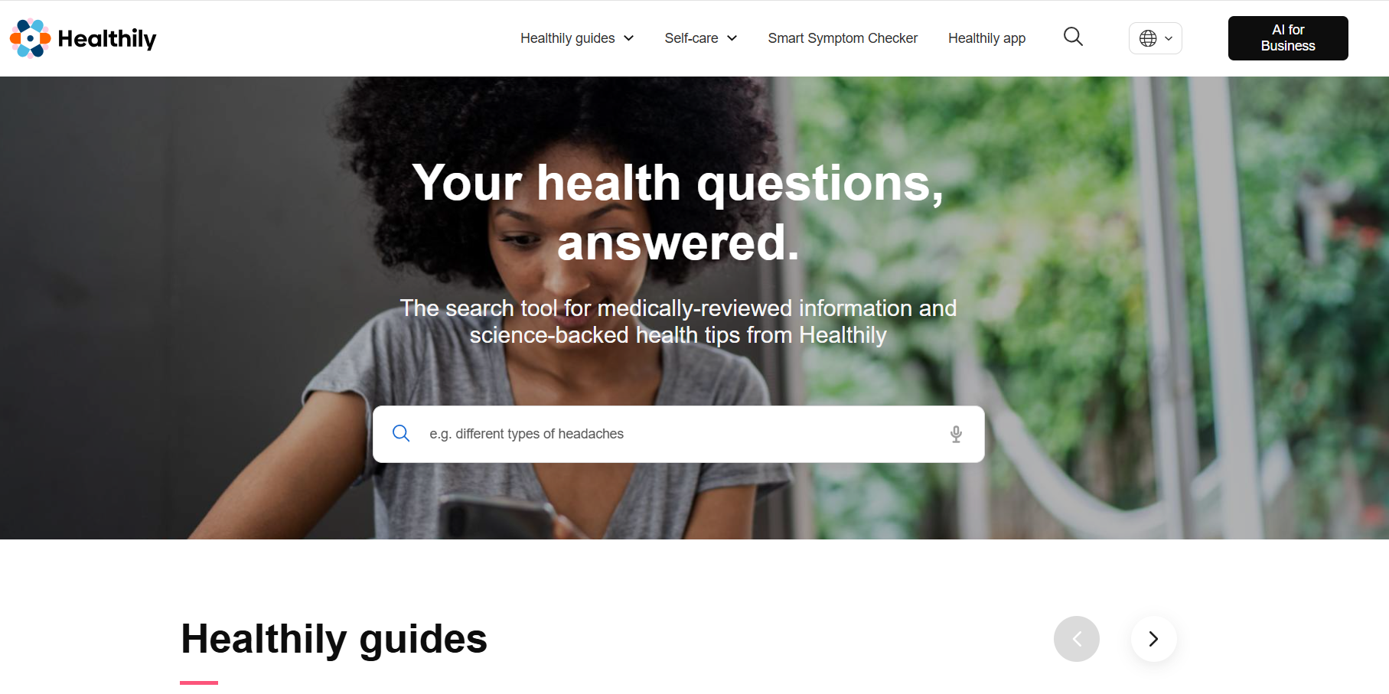
Your.MD [your.md]
Strengths:
High diagnostic accuracy (85–97%) for common conditions.
Integrates both symptom and image-based diagnostics for a more complete analysis.
Utilizes explainable AI (XAI) to provide transparent, confidence-scored results.
Offers users structured, understandable diagnostic reasoning, improving trust and clarity.
Limitations Addressed by Tashkhisi:

Slide 13
01
External medical knowledge bases
Methodology
Employs pre-trained machine learning models such as:
YOLOv5, FastAI for image-based medical analysis (e.g., malaria, dermatological conditions).
Random Forest, Logistic Regression for tabular data predictions (e.g., diabetes, heart disease).
TASHKHISI platform adopts a hybrid, multi-layered methodology that combines:
02
User-centric design
Prioritizes usability, accessibility, and personalization, ensuring ease of use across devices and demographics.

Slide 14
03
Multimodal diagnostic integration
Methodology
Inspired by frameworks like HAIM, the system fuses inputs from multiple sources (symptoms, images, demographics).
Uses a weighted ensemble method to merge AI model predictions and API outputs.
TASHKHISI platform adopts a hybrid, multi-layered methodology that combines:
04
Cloud-native deployment
Built with Flask, deployed using Docker, Celery, and cloud platforms like AWS/Google Cloud for scalability and high availability.

Slide 15


Symptom-Based Diagnosis
Users input symptoms and demographic data via a responsive web interface.
Integrated with Priaid API for fast, evidence-based condition prediction.
Proposed Approach
Image and Data-Based AI Predictions
Supports uploading medical images (e.g., blood smears), which are analyzed using YOLOv5 and FastAI.
Tabular health data (e.g., BMI, blood pressure) is processed using Random Forest and Logistic Regression models.
The proposed approach addresses key limitations of existing medical diagnostic platforms through:
User Management and Personalization
Secure login (Flask-Login, OAuth 2.0), profile tracking, and personalized diagnostic recommendations.
Targets region-specific health concerns like malaria, diabetes, and thalassemia.

Slide 16
Multimodal Fusion for Enhanced Accuracy
Combines outputs from both symptom-based API and AI models using a weighted ensemble approach.
Proposed Approach
Explainable Results
SHAP and LIME provide interpretable insights into predictions to boost user trust and compliance.
The proposed approach addresses key limitations of existing medical diagnostic platforms through:
Security and Compliance
Fully compliant with HIPAA and GDPR, with encrypted data storage and role-based access.
Scalability and Performance
Uses Celery for asynchronous processing, Docker for containerization, and load balancing for performance under high traffic.

Slide 17
Machine learning
Machine learning allows computers to learn patterns from data and make predictions or decisions without being explicitly programmed.
In this project:
Used Random Forest for predicting diabetes and fetal health conditions.
Used Logistic Regression for heart disease prediction.
Applied YOLOv5 for malaria detection in blood images.
Used FastAI with CNNs (e.g., ResNet) for skin lesion and image classification.
Combined all predictions using a multimodal ensemble for improved accuracy.

Slide 18
Ultralytics YOLOv5
YOLO (You Only Look Once) is a real-time object detection system that identifies objects in images using bounding boxes.
In this project:
Used for detecting malaria parasites in blood smear images.
Fine-tuned on medical datasets for accuracy.
Outputs bounding boxes and confidence scores for infected cells.
Integrated with FastAI for further classification.

Slide 19
FastAI
FastAI is a deep learning library built on top of PyTorch, designed to simplify training neural networks.
In this project:
Used for classifying images (e.g., skin diseases).
Applied transfer learning using pre-trained CNNs.
Used Grad-CAM for visual explainability.
Combined with YOLO for two-stage malaria analysis.

Slide 20
Scikit-learn
scikit-learn is a machine learning library in Python that supports classification, regression, and clustering.
In this project:
Used to implement Random Forest and Logistic Regression models.
Applied PCA, StandardScaler, and RobustScaler for preprocessing.
Used for training, validating, and tuning tabular health data models.

Slide 21
Priaid API
Priaid is a medical API that offers symptom-based diagnosis and medical information.
In this project:
01. Receives user input (symptoms, gender, birth year).
02. Returns possible conditions ranked by confidence score.
03. Supports Arabic language for regional diagnostics.
04. Used as a primary source in multimodal fusion.

Slide 22
Multimodal Fusion
Combining outputs from multiple sources (symptoms, image, tabular data) to enhance diagnostic accuracy.
In this project:
Combined predictions from Priaid API and AI models.
02. Weighted results based on confidence and context.
03. Improved performance by 6–33%.
04. Integrated with SHAP and LIME for transparency.

Slide 23
NumPy & Pandas
NumPy is used for numerical operations; Pandas is used for data manipulation and analysis.
In this project:
Cleaned and processed tabular health data.
Normalized features like BMI, glucose, and cholesterol.
Handled missing values and transformations before model input.

Slide 24
OpenCV & PIL
OpenCV is an image processing library; PIL (Pillow) handles image formats.
In this project:
Resized and normalized blood smear and skin images.
Handled image conversion for FastAI compatibility.
Applied augmentation and preprocessing for model training.

Slide 25
Werkzeug Security
Werkzeug provides secure password hashing and authentication support.
In this project:
Used to hash user passwords during registration.
Implemented secure login using Flask-Login.
Prevented brute-force and credential attacks.

Slide 26
Flask Web Framework
Flask is a lightweight Python web framework for backend development.
In this project:
01. Handled user routing (e.g., /login, /diagnose, /history).
02. Integrated with Priaid API and AI models.
03. Used Jinja2 for dynamic content rendering.
04. Managed sessions, requests, and responses.

Slide 27
SQLAlchemy + MySQL
SQLAlchemy is an ORM for database access. Used to interact with the MySQL database, managing data related to users, symptoms, diseases, and doctors. It simplifies database operations and ensures efficient data retrieval and updates. MySQL is a relational database system.
In this project:
Stored user data, symptoms, diagnoses, and history.
Used SQLAlchemy for Python-to-DB mapping.
Enabled fast, secure queries with transaction support.

Slide 28
Front-end Technologies
HTML, CSS, JavaScript, jQuery
In this project:
Built responsive user interfaces .
Rendered pages using Jinja2 templates.
Used JavaScript and AJAX for real-time interaction.
Supported Arabic RTL layout and accessibility features.

Slide 29
Front-end Technologies
HTML:
Role: HTML provides the structure of the webpage. It defines elements such as the header, forms for entering symptoms, sections for displaying disease predictions, and areas to show doctor information. It acts as the skeleton of the page where all the content is organized.
CSS:
Role: CSS is used to style the HTML structure, adding colors, fonts, spacing, and layout to make the webpage visually appealing. It ensures the design is user-friendly, responsive, and aligns with the overall branding of the project.
JavaScript (JS):
Role: JavaScript makes the webpage interactive. It handles dynamic tasks such as submitting user input (symptoms), fetching disease predictions, and displaying the results without needing to reload the page. It communicates with the backend through JSON, enabling real-time data exchange.
Jina:
Role: Jina is used for building the AI-based language model that processes user input. It helps handle natural language understanding on the frontend, processing user symptoms and assisting in generating accurate disease predictions based on the input.

Slide 30

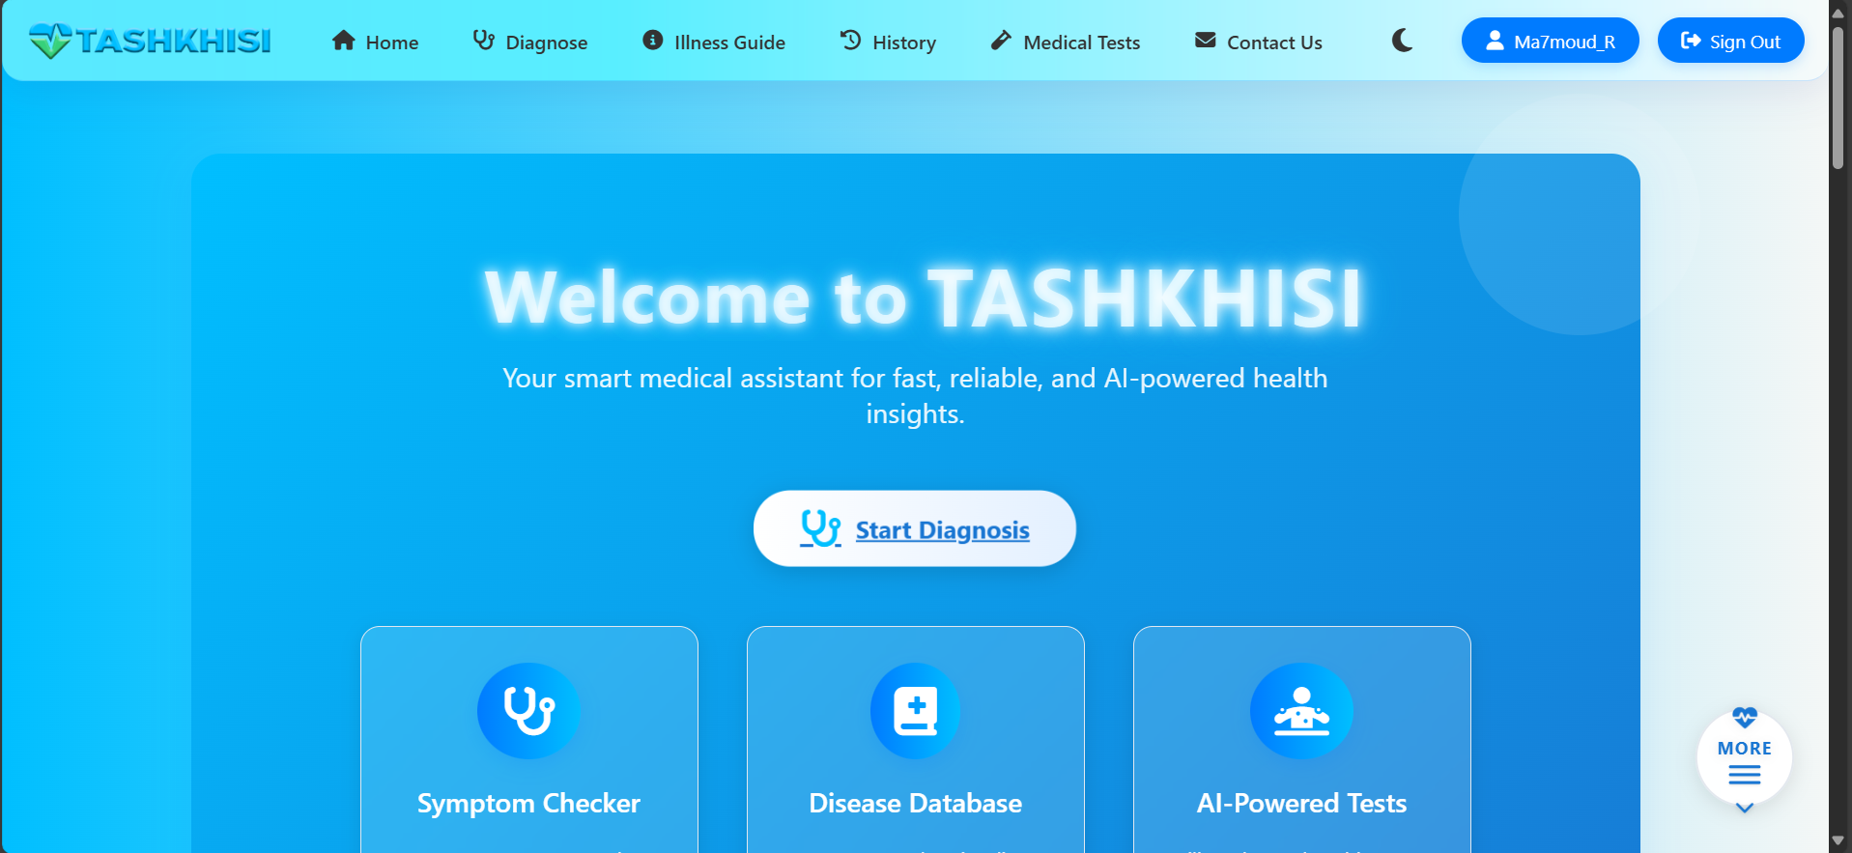
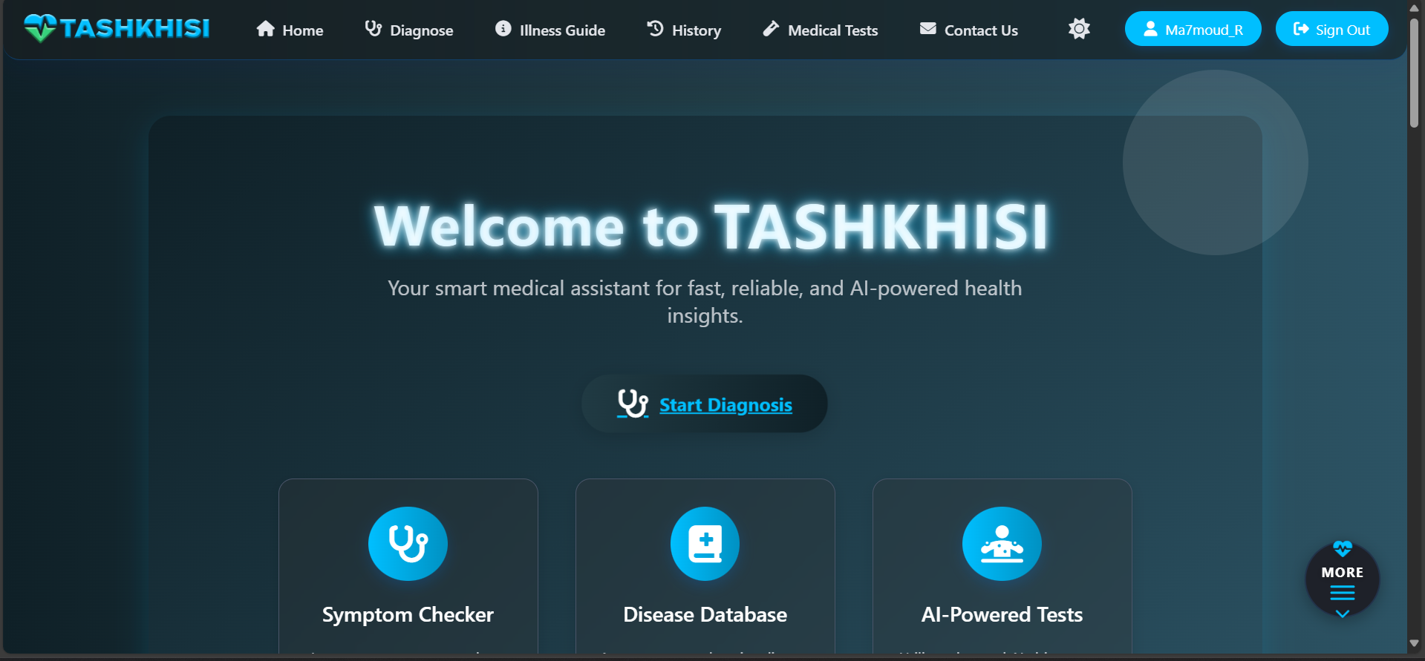

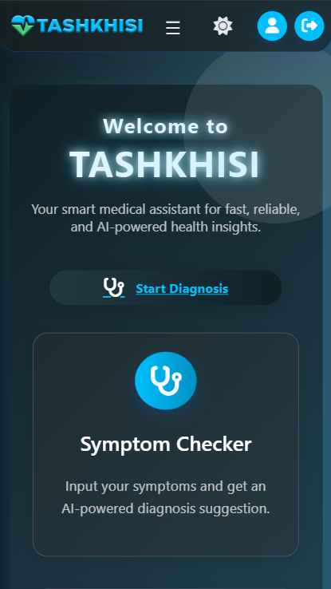
Home Page
This page is the main page on our website that help you to reach all other pages easily.
01

Slide 31
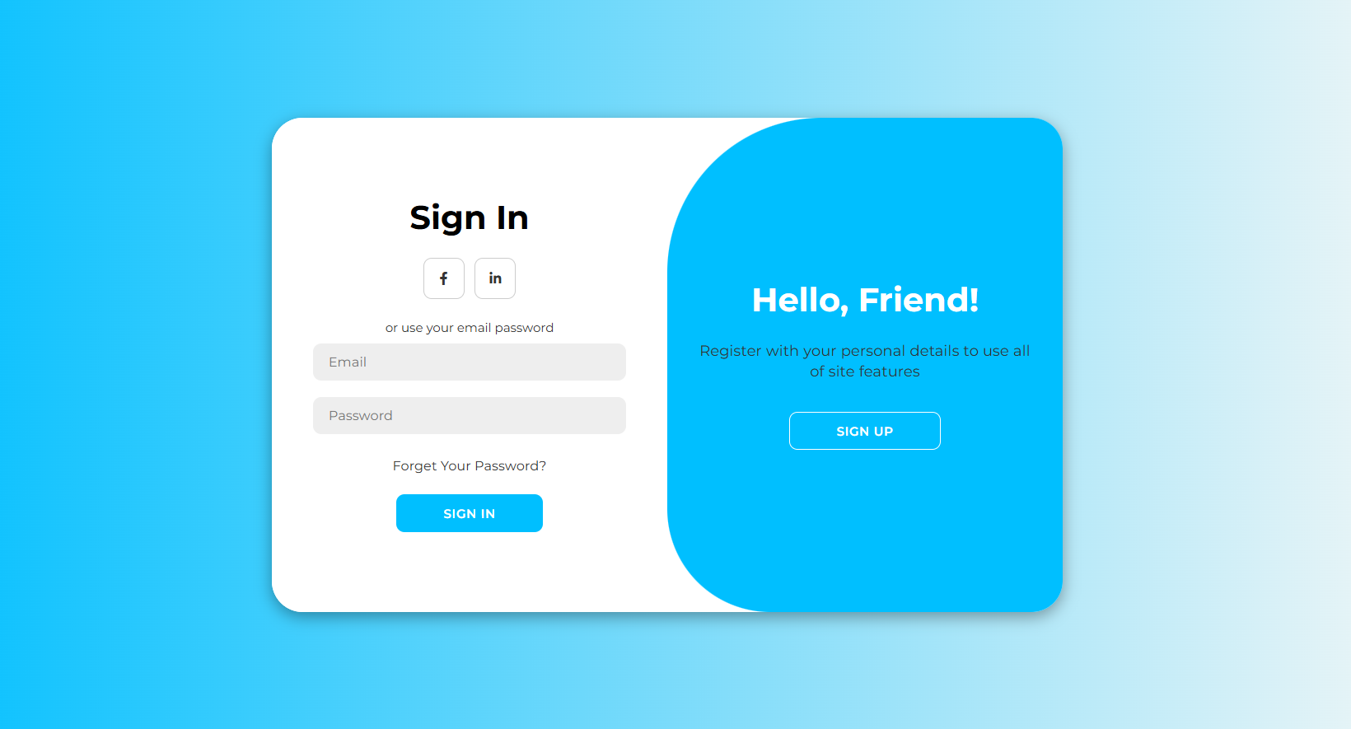
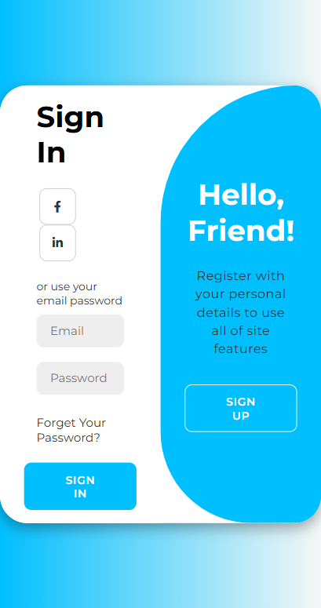
Sign-in Page
If you have an account, you can enter the username and password to use all the services provided by the program
01

Slide 32
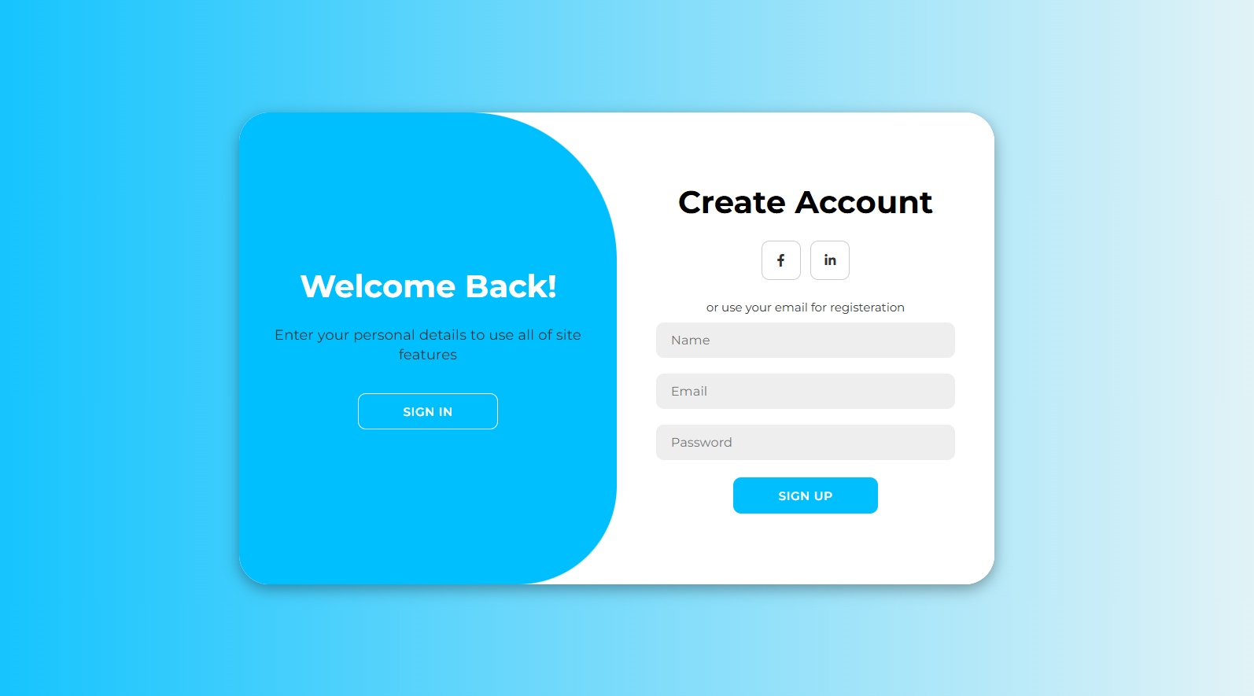
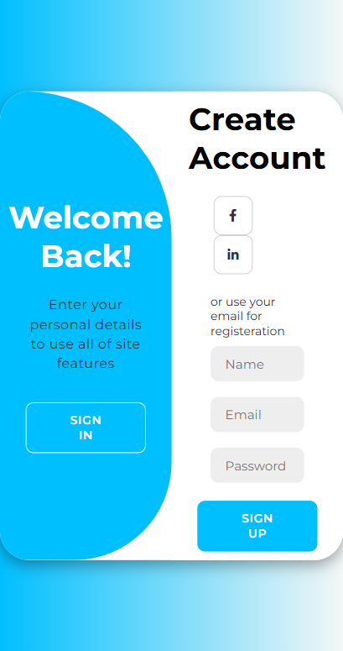
Register Page Page
If you do not have an account, you can create an account to be able to use all the services provided by the program.
01

Slide 33
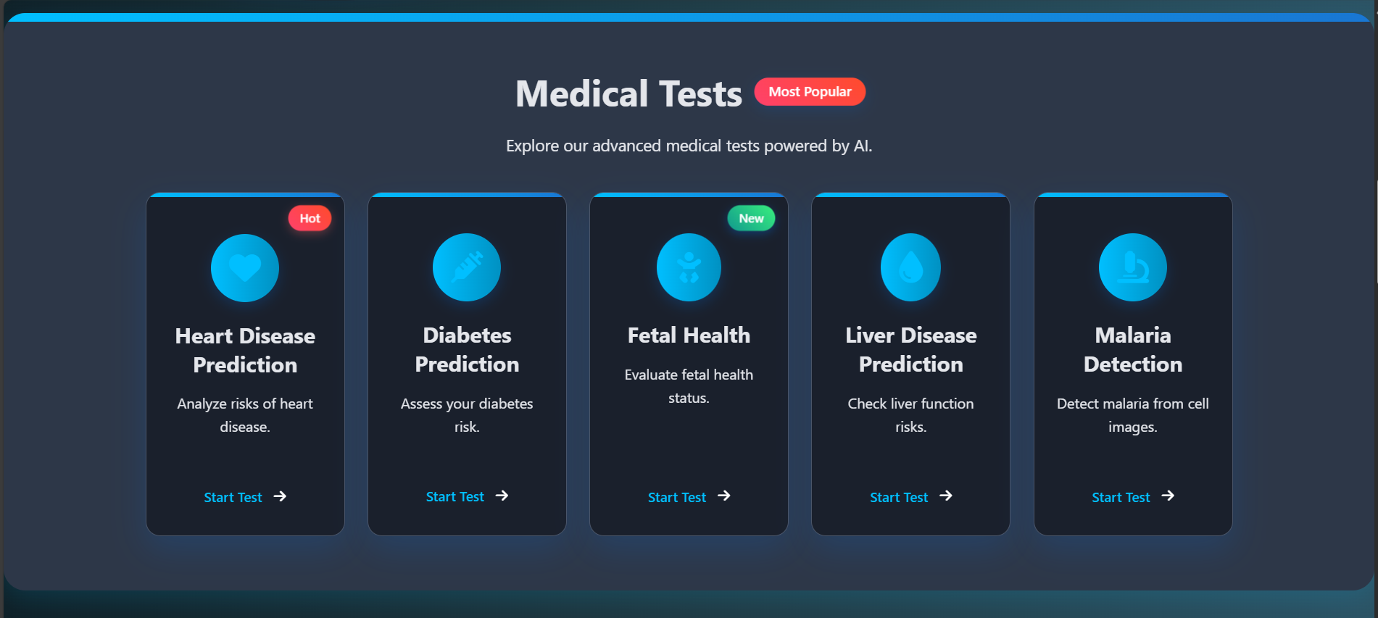
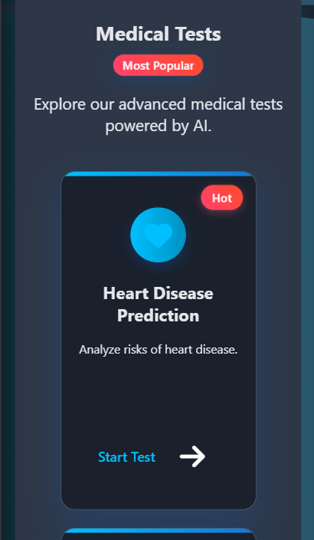
Medical tests Page
This page allows users to input medical data (e.g., glucose or cholesterol levels) or upload test images for analysis by AI models. It provides instant results with explanations and recommendations for health follow-up.
01

Slide 34
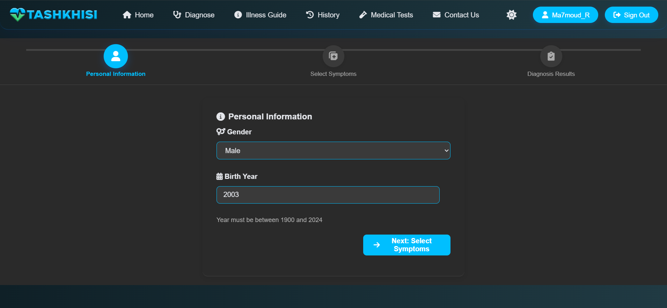
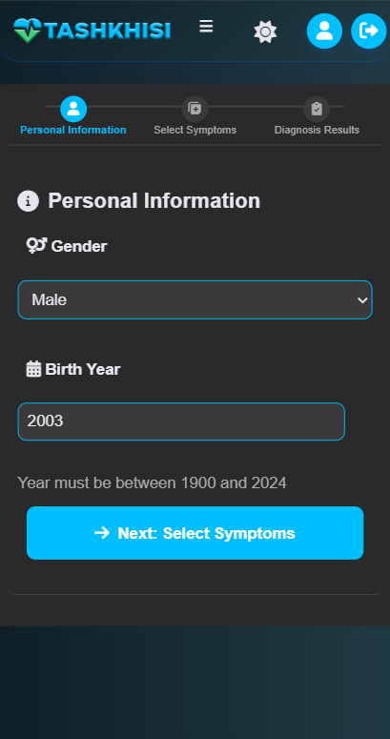
Diagnose Page
This page enables users to enter symptoms (e.g., fever, cough) and details like gender and age, via a user-friendly interface.
01

Slide 35
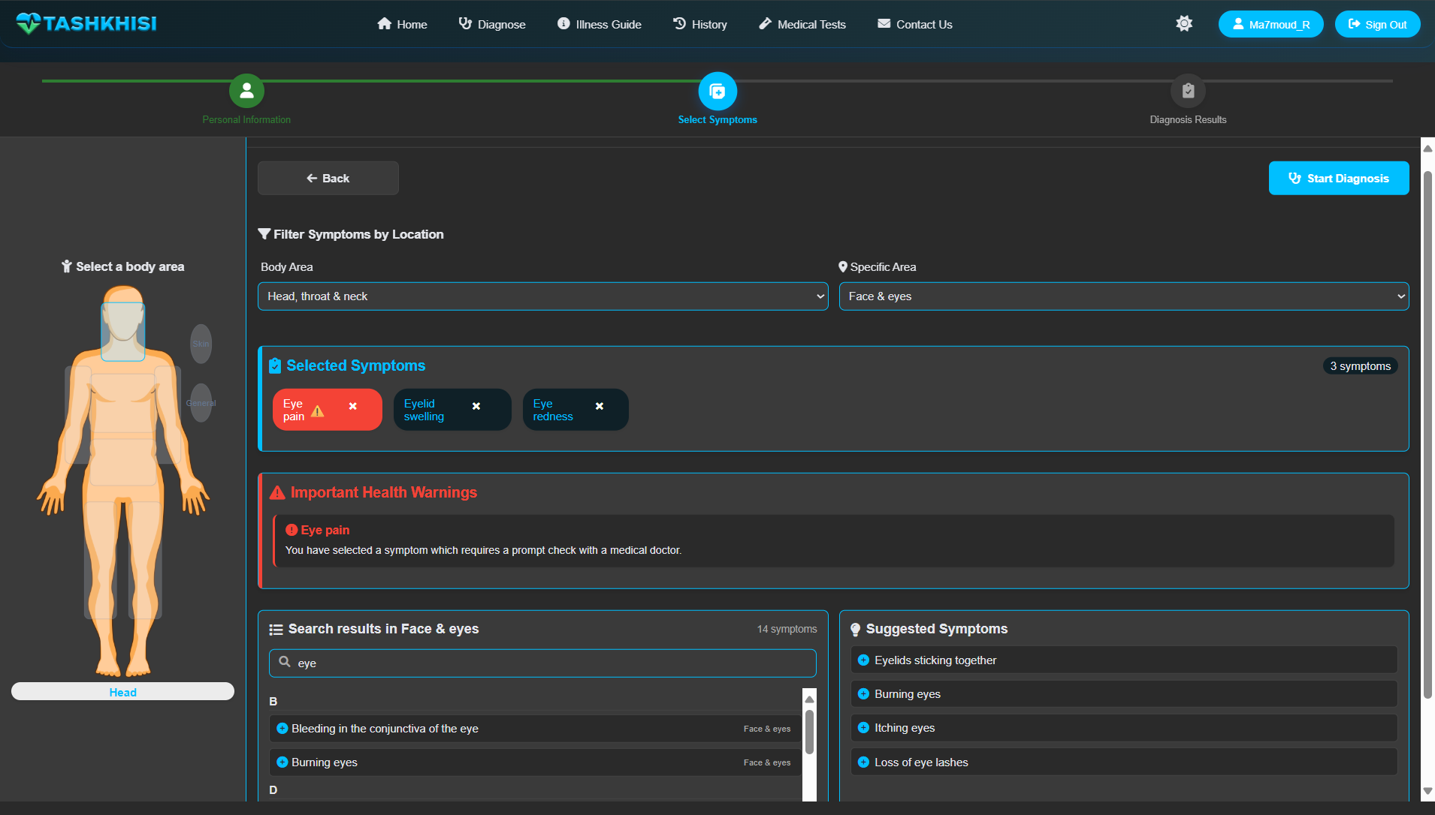
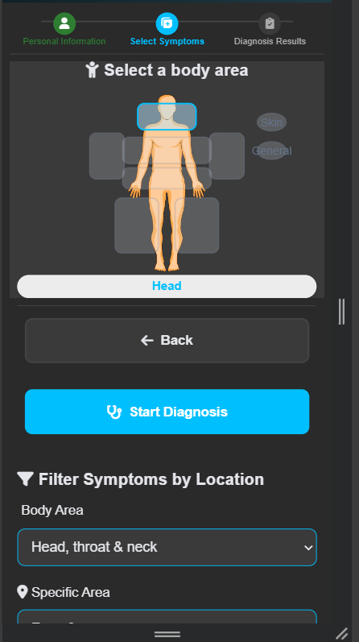
Diagnose Page(cont.)
Symptoms are sent to the Priaid API for analysis,, ensuring accurate preliminary results.
01

Slide 36
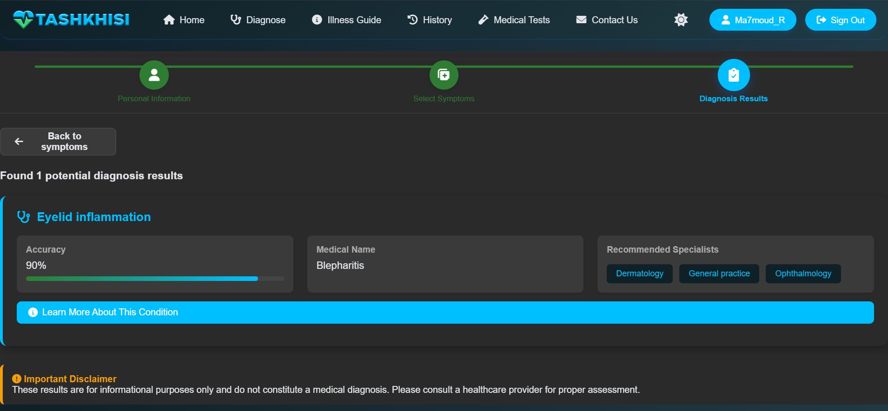
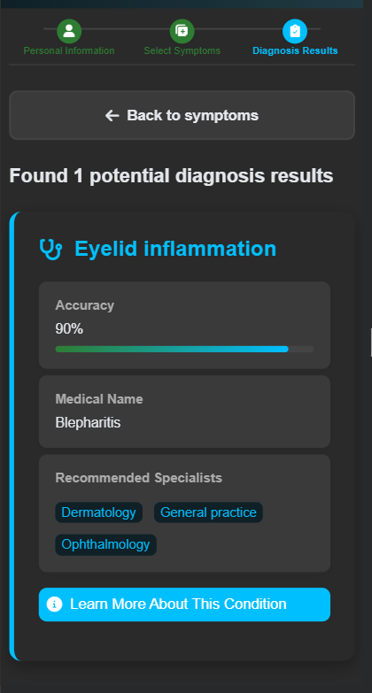
Diagnose Page(cont.)
01

Slide 37
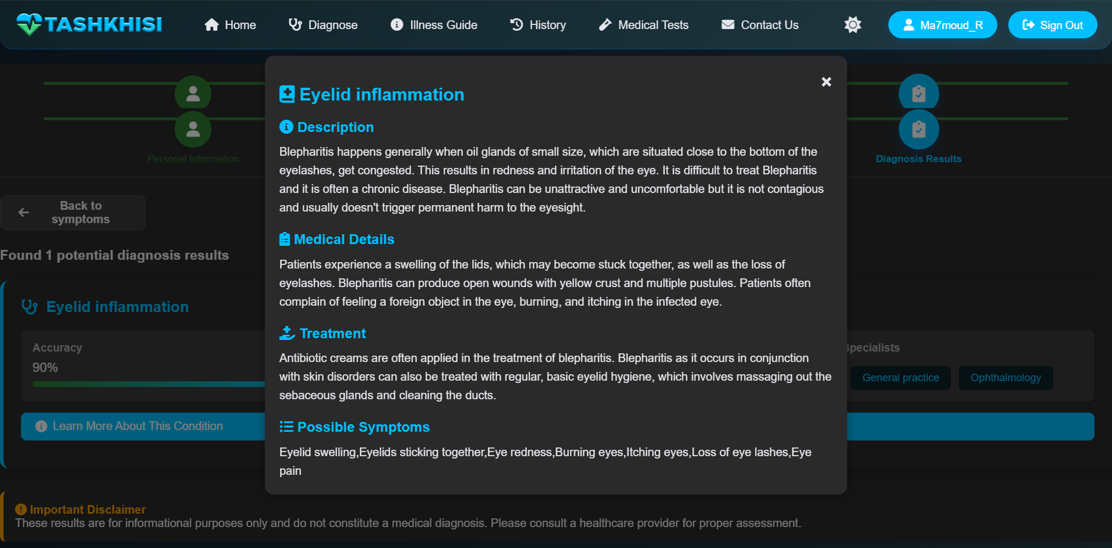
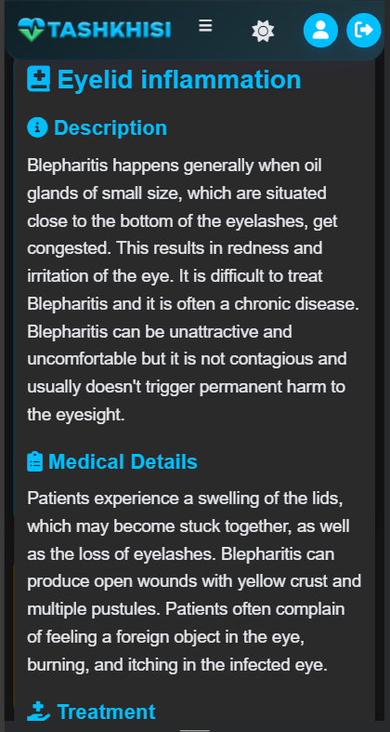
Diagnose Page(cont.)
01

Slide 38
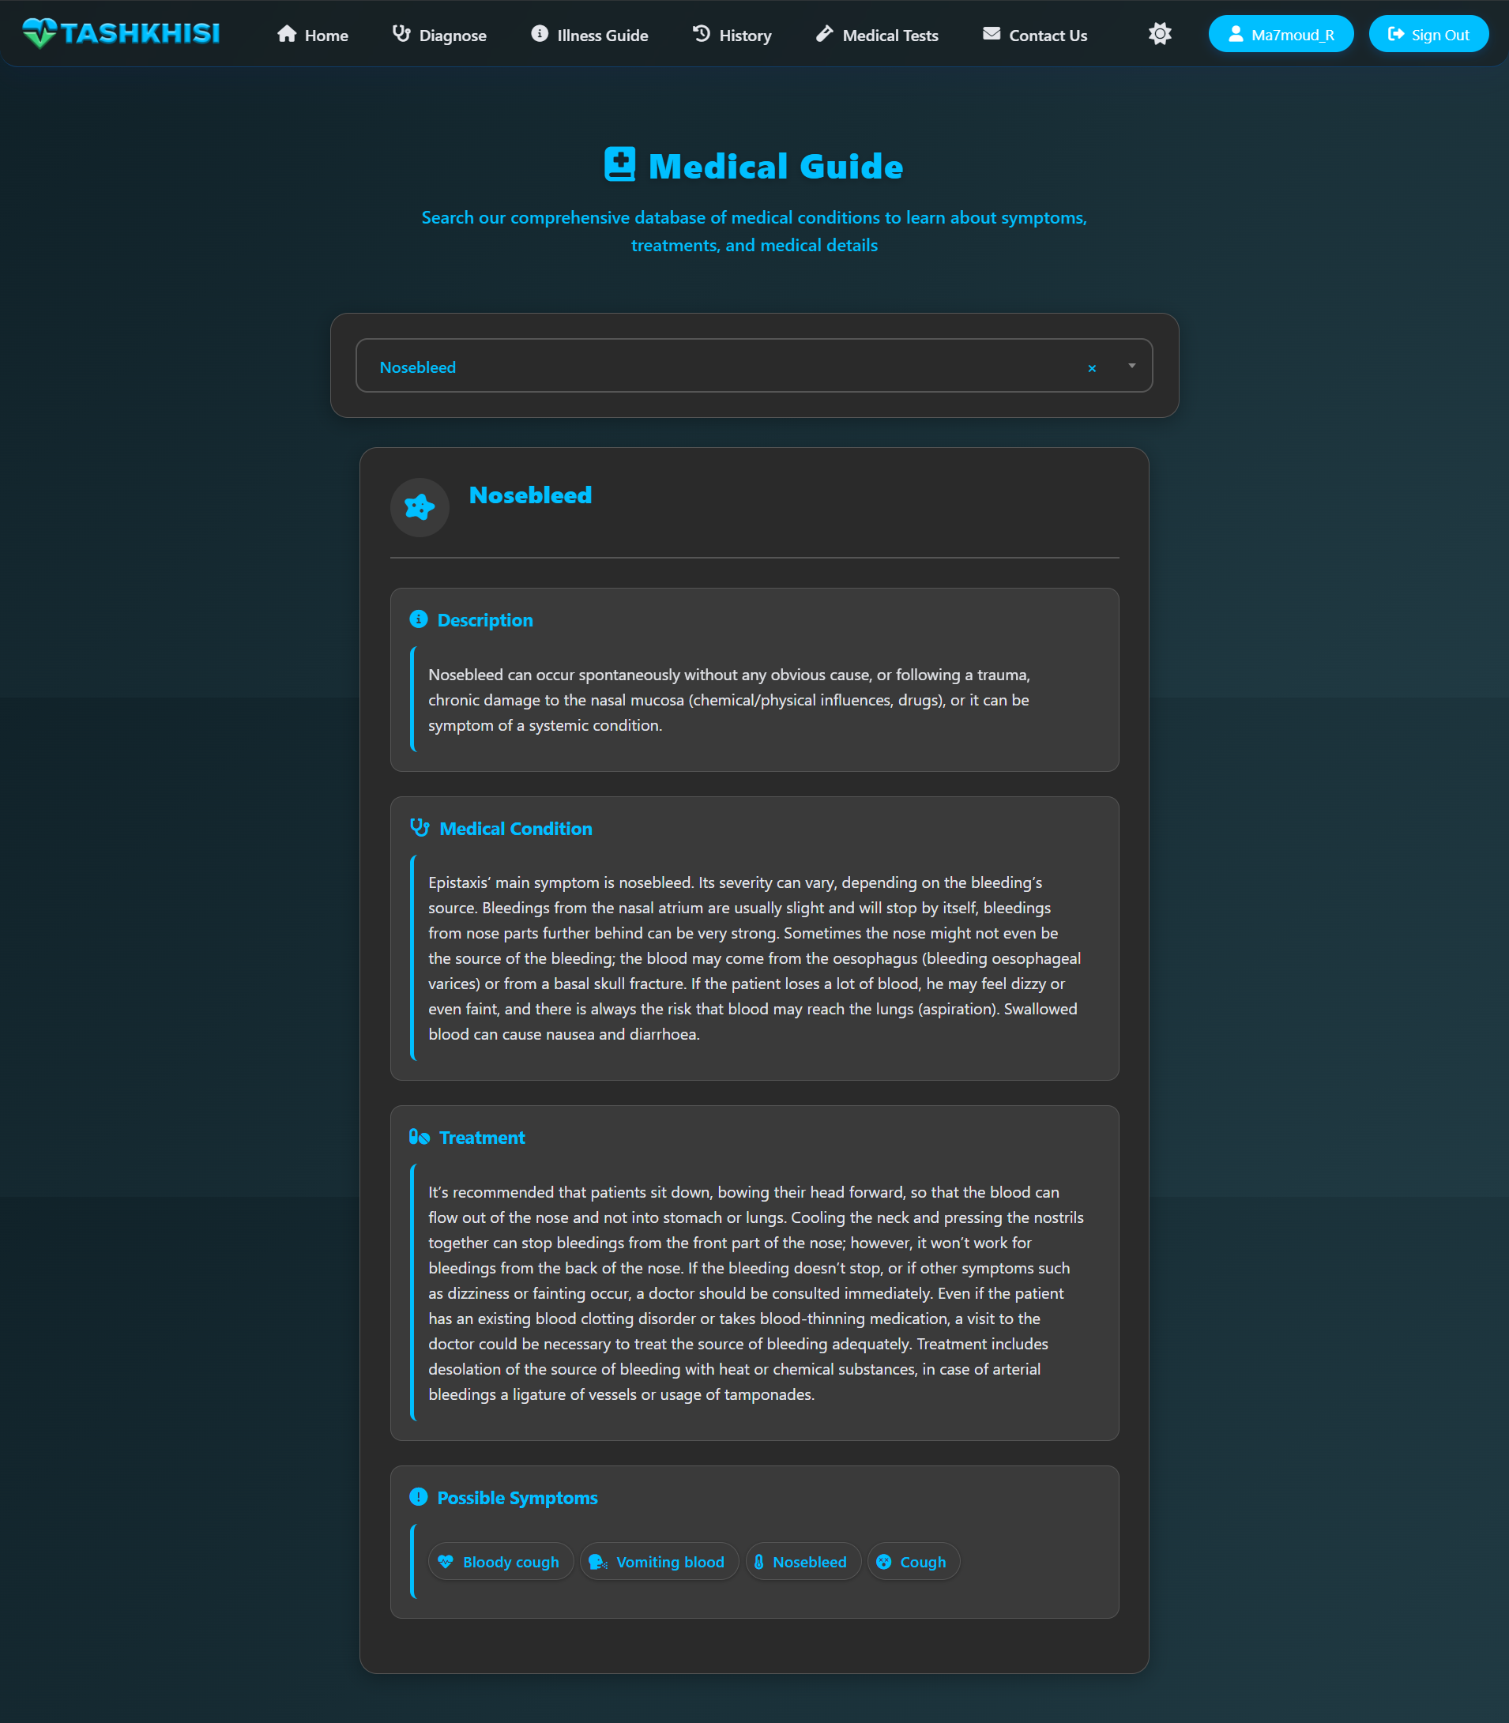
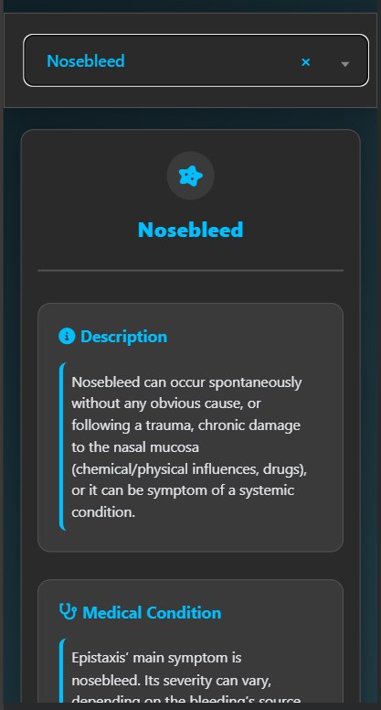
Illness guide Page
This page provides detailed, medically vetted information on various conditions, including symptoms, causes, diagnostics, and treatment options.
01

Slide 39
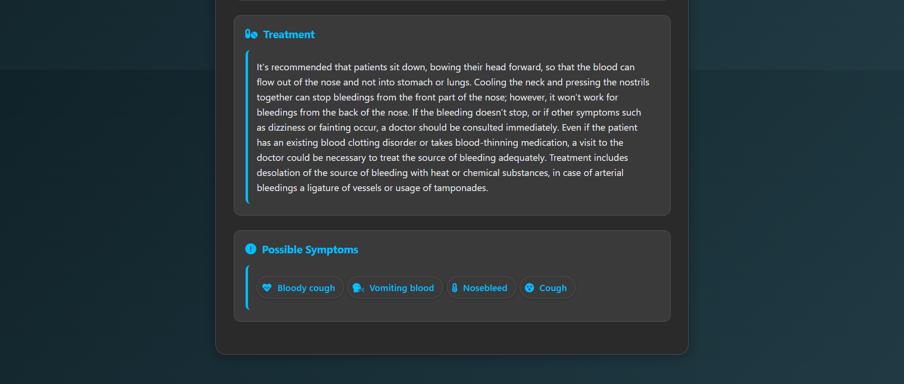
Illness guide Page
This page provides detailed, medically vetted information on various conditions, including symptoms, causes, diagnostics, and treatment options.
01

Slide 40
Illness guide Page
01

Slide 41
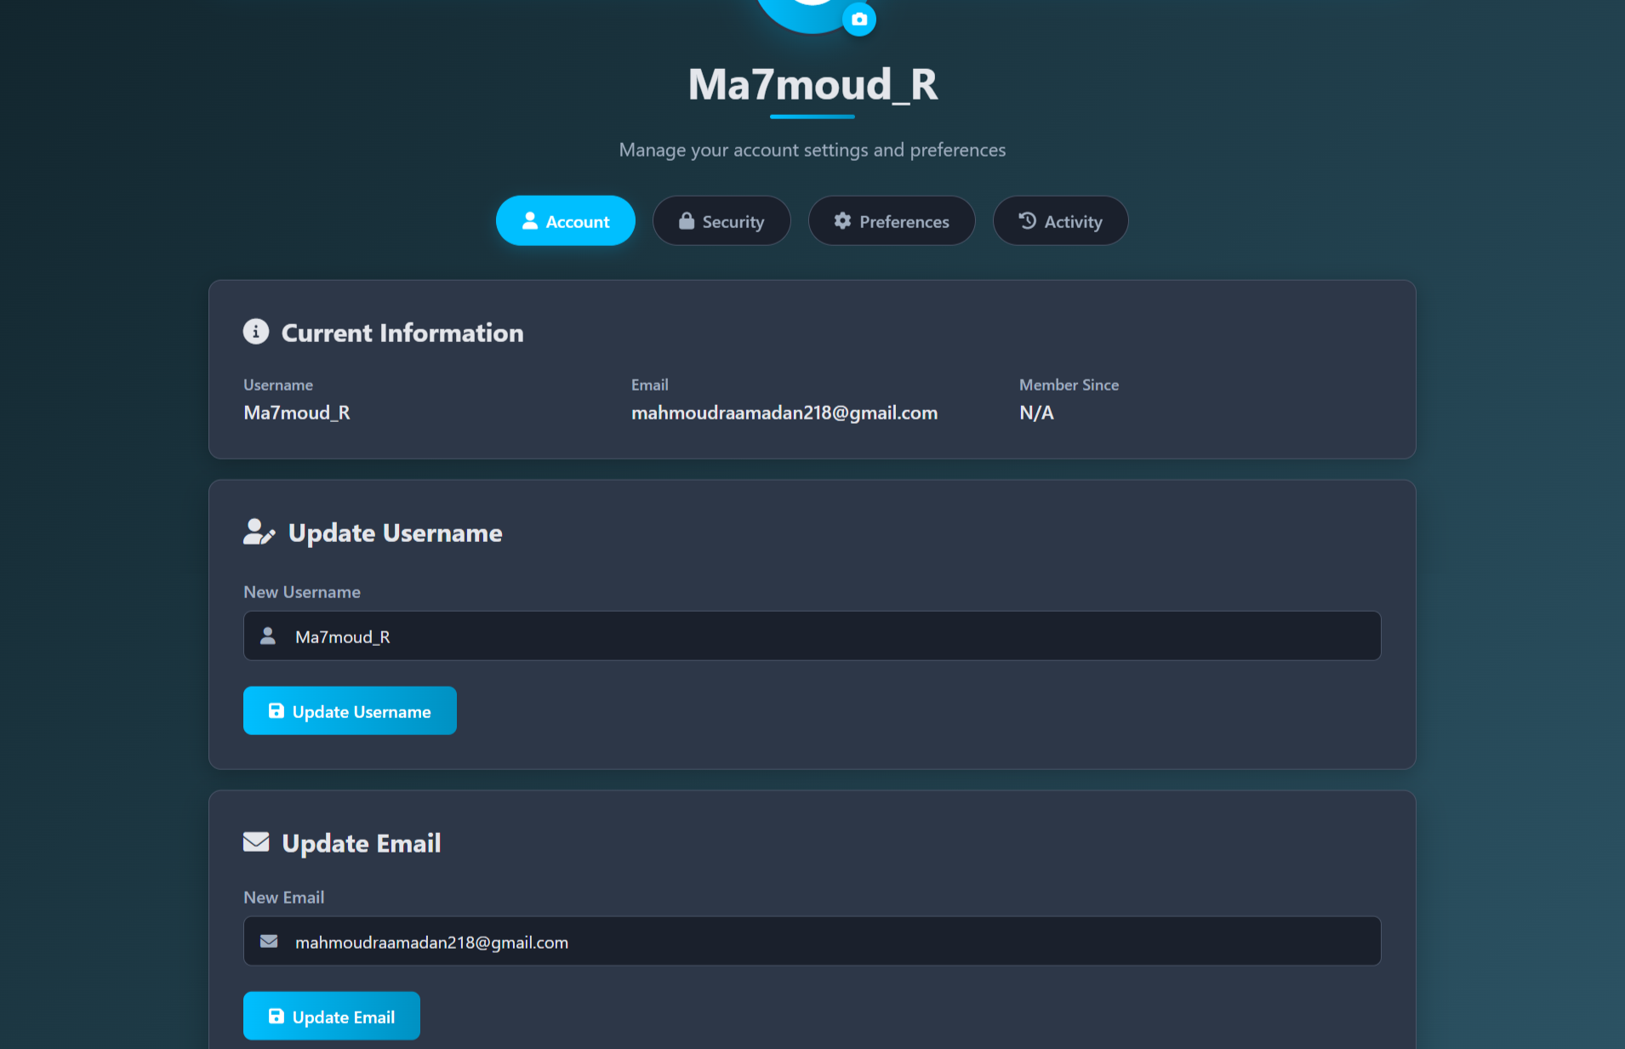
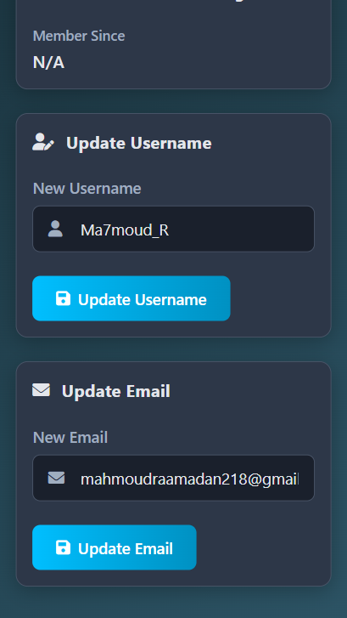
Profile Page
This page allows users to manage personal information, update health data, and review past diagnoses securely.
01

Slide 42
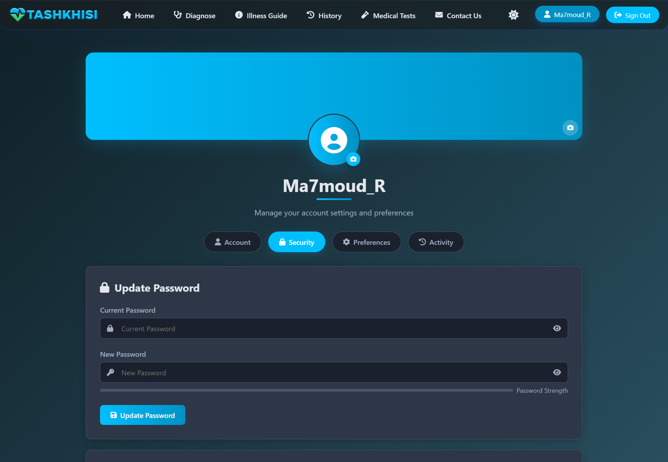
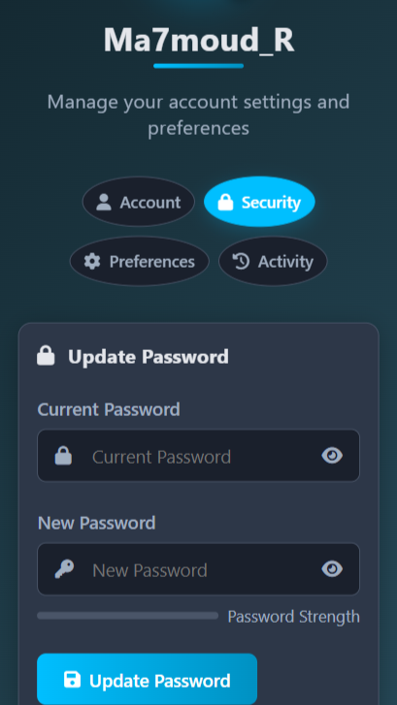
Profile Page
01

Slide 43
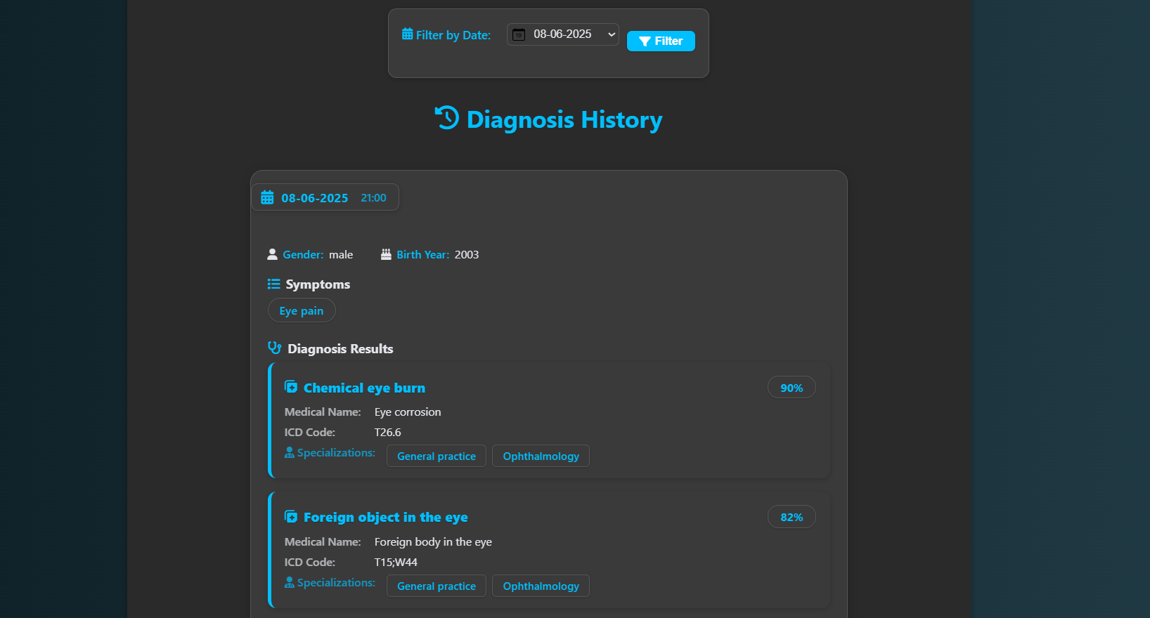
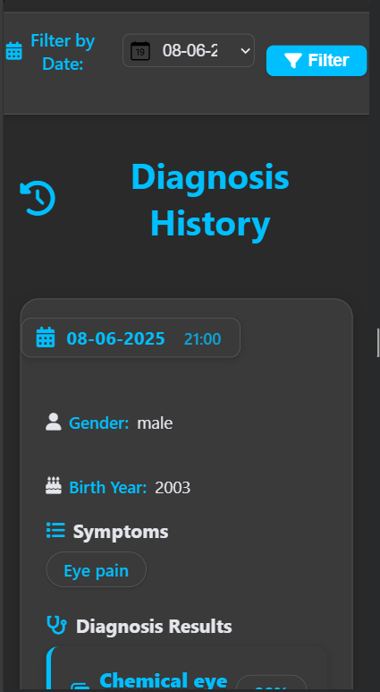
History Page
This page enables users to view and manage their past diagnosis records and health reports for longitudinal tracking.
01

Slide 44
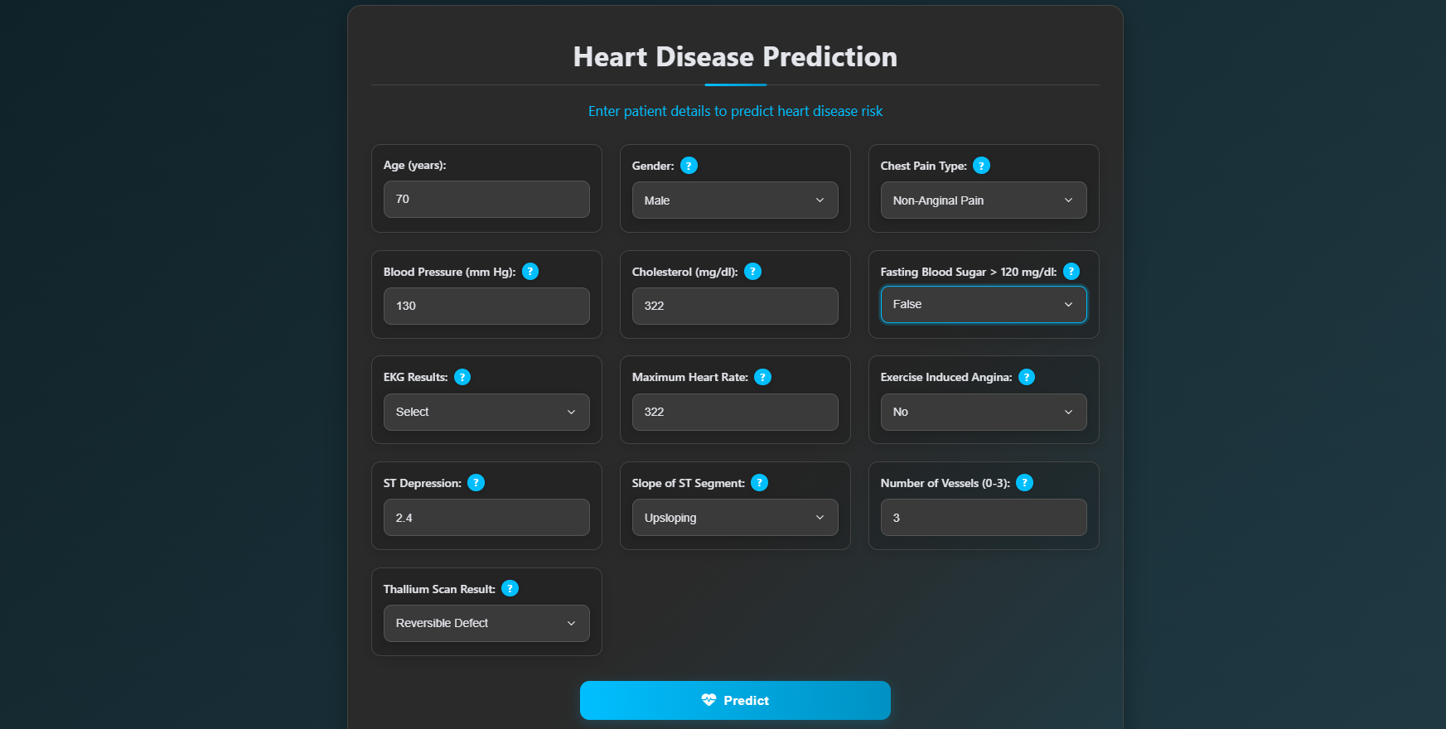
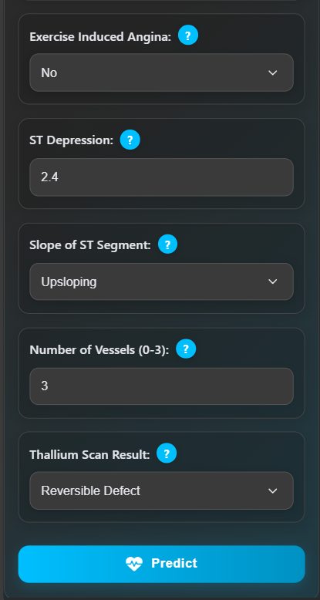
Heart disease test Page
This page enables users to input health metrics (e.g., cholesterol, blood pressure) for analysis by AI models like Logistic Regression.
01

Slide 45
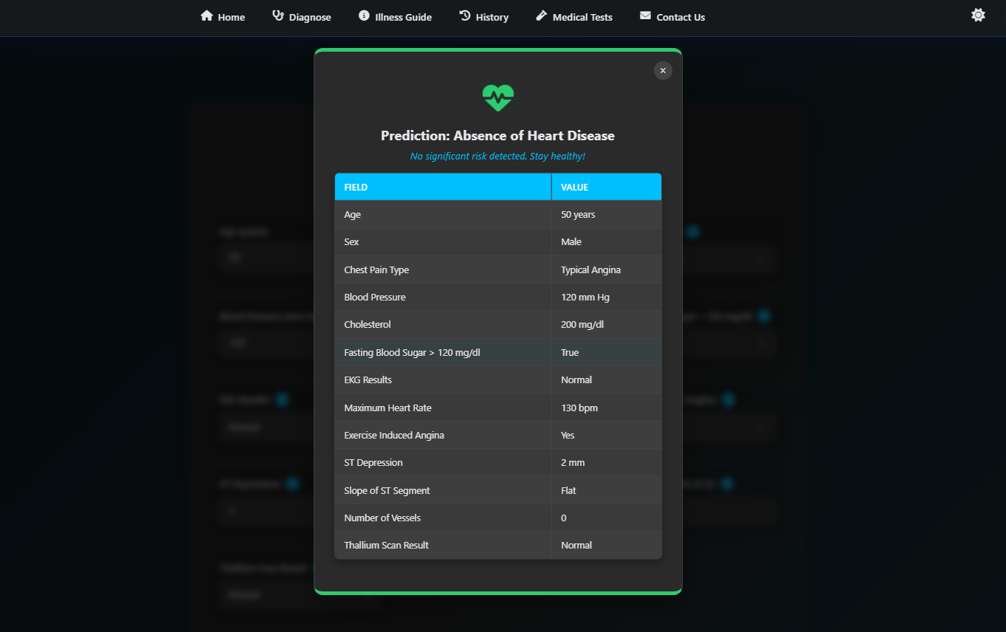
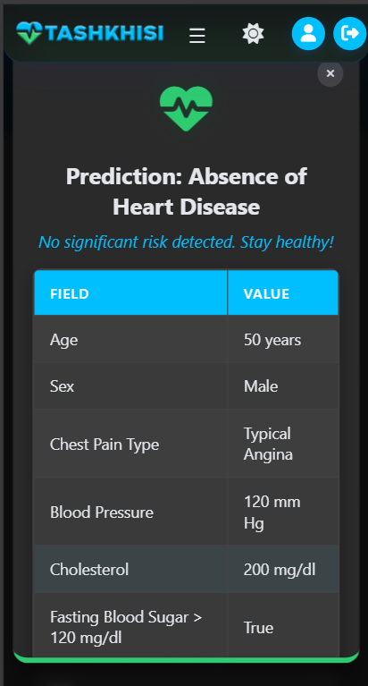
Heart disease test Page(cont.)
Also It delivers immediate predictions of heart disease risk with guidance for further medical consultation.
01

Slide 46
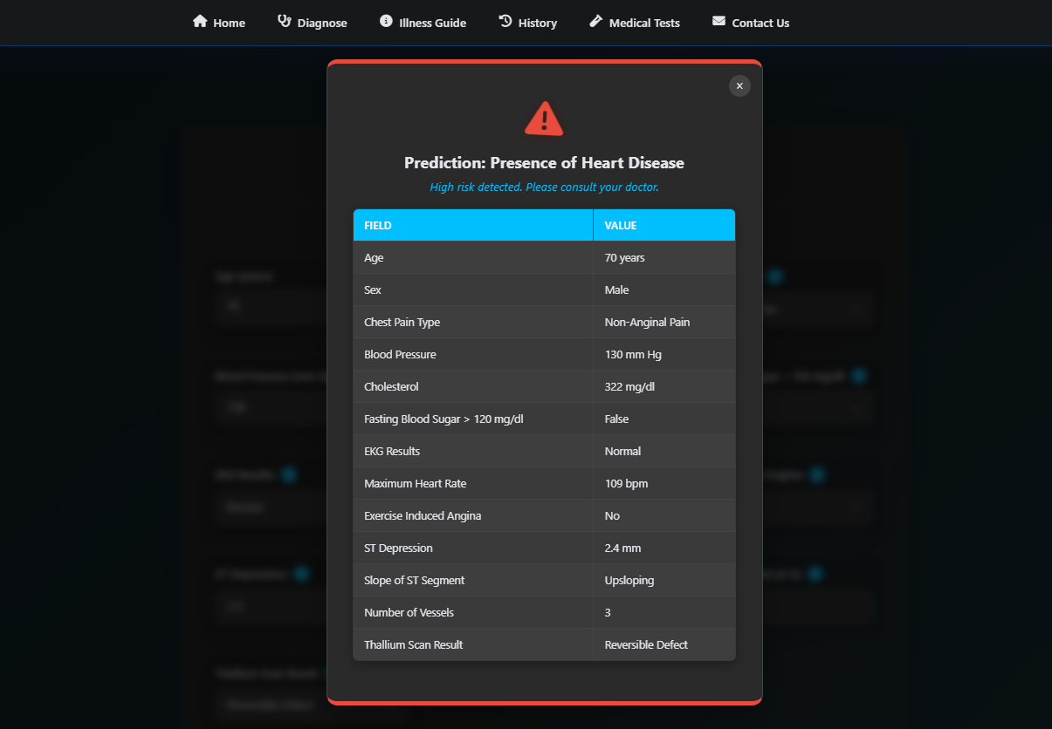
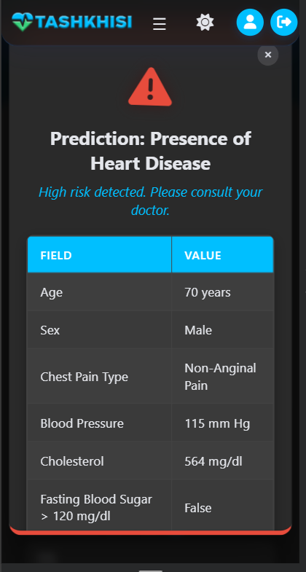
Heart disease test Page(cont.)
01

Slide 47
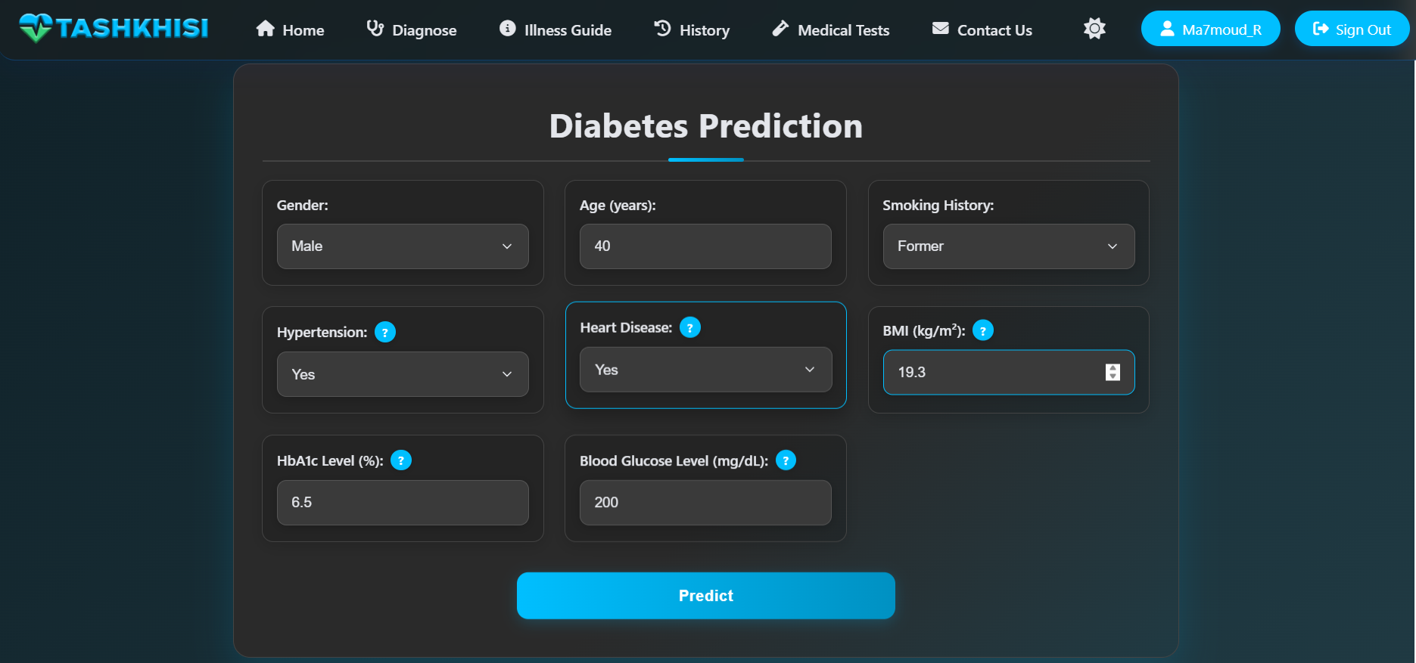
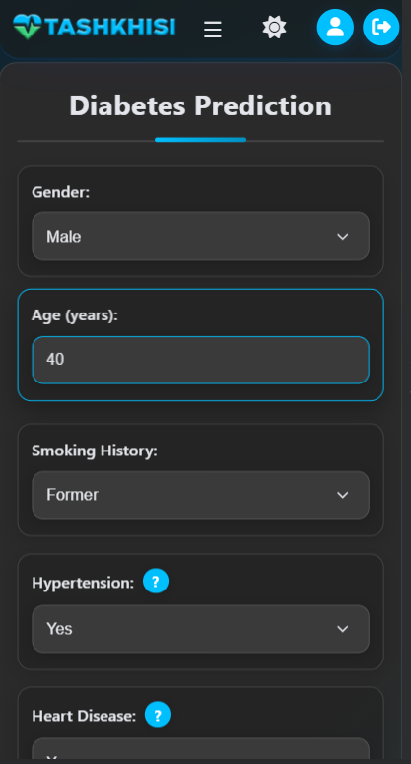
Diabetes test Page
This page allows users to enter medical data (e.g., glucose levels, BMI) for analysis by AI models like Random Forest
01

Slide 48
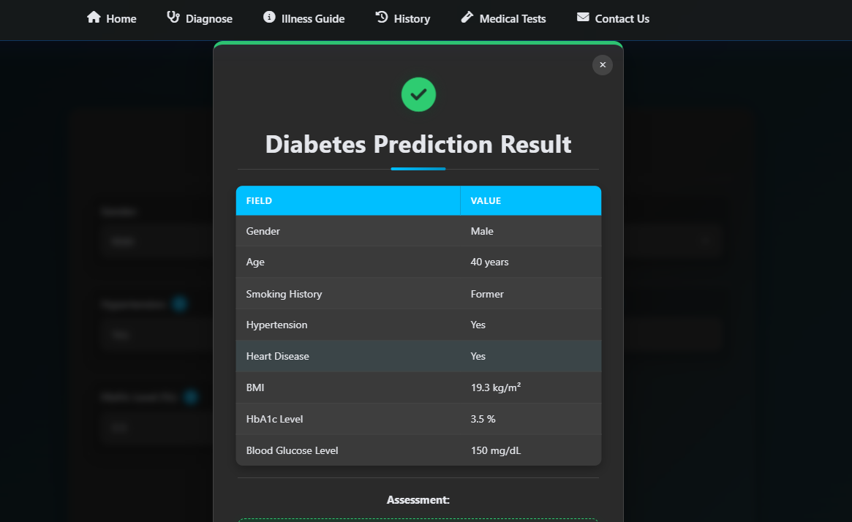
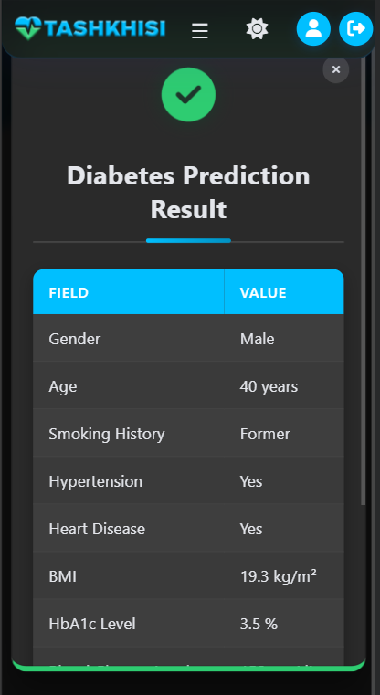
Diabetes test Page(cont.)
Also It provides instant predictions of diabetes risk with recommendations for health management or specialist consultation.
01

Slide 49
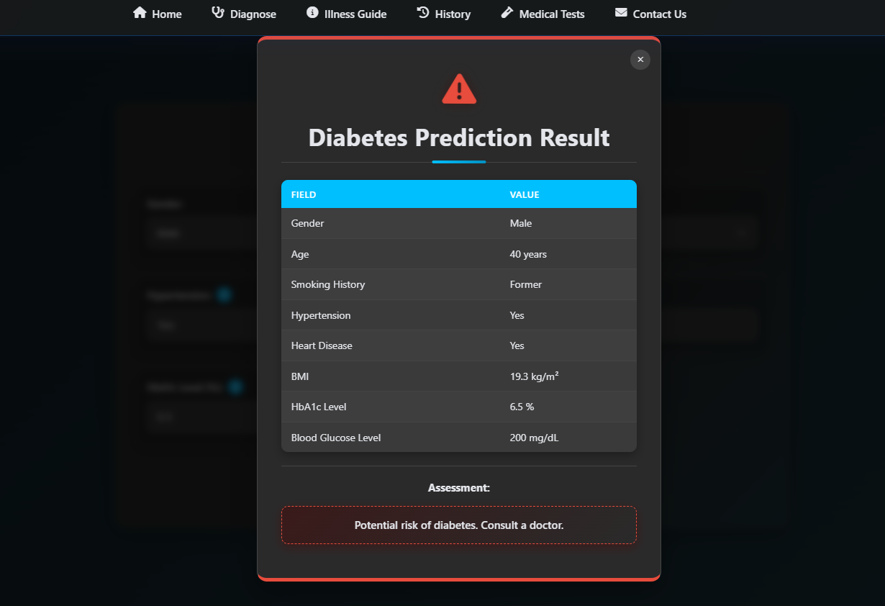
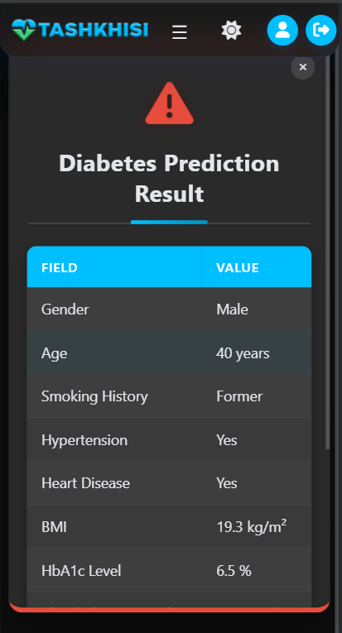
Diabetes test Page(cont.)
01

Slide 50
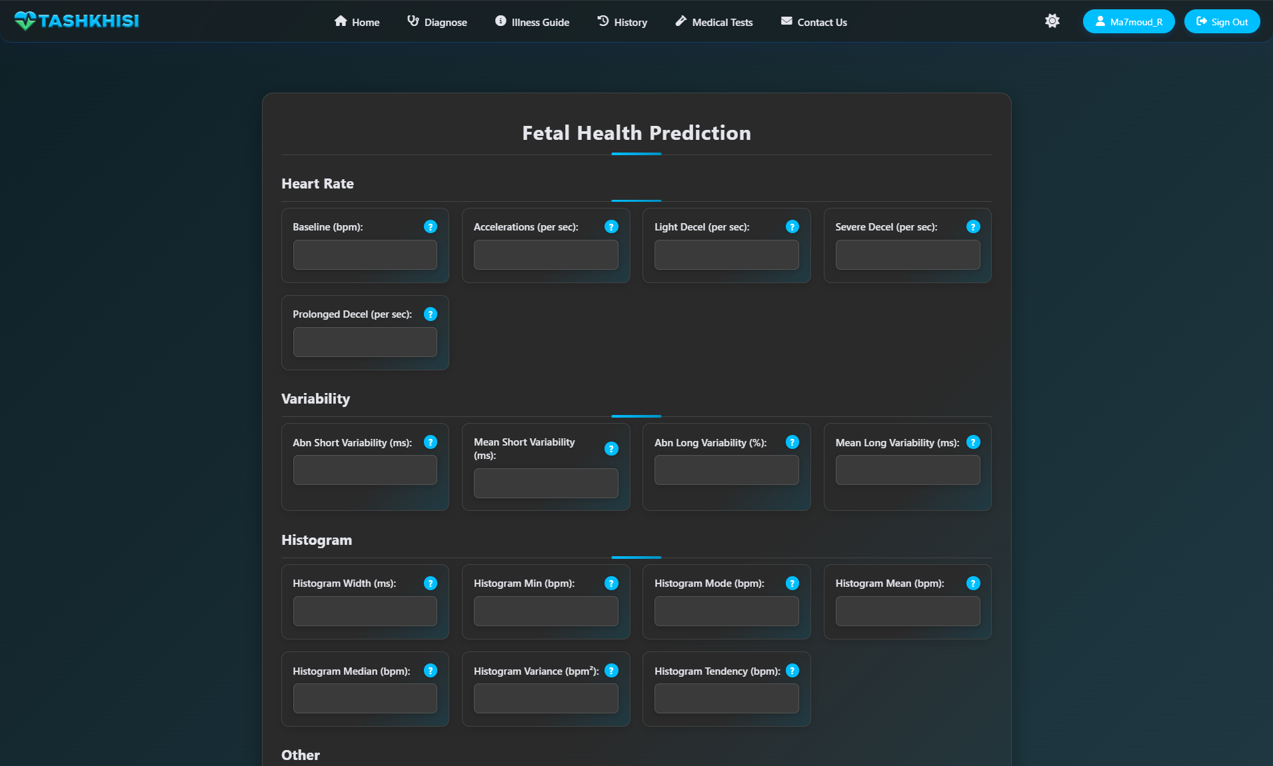
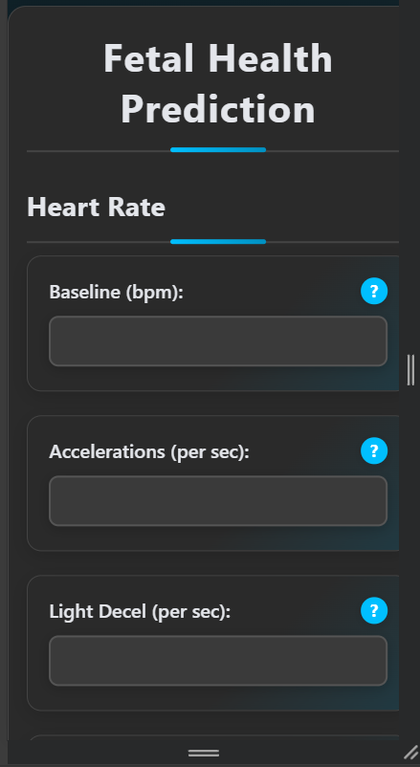
Fetal test Page
enables users to input cardiotocography data or related metrics for analysis by AI models like Decision Trees.
01

Slide 51
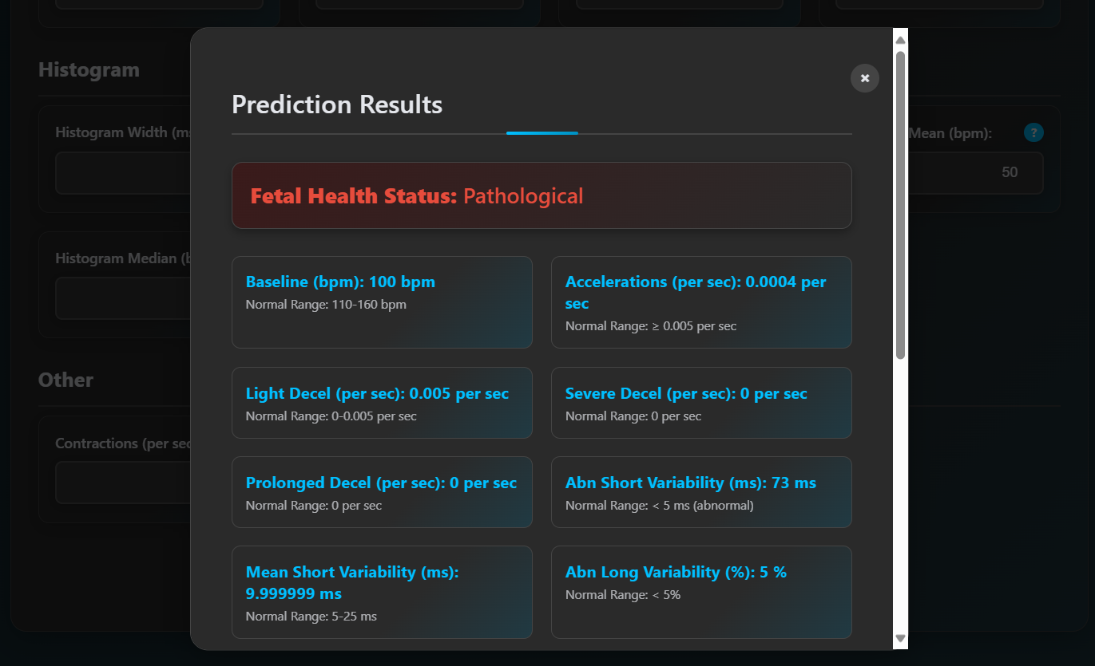
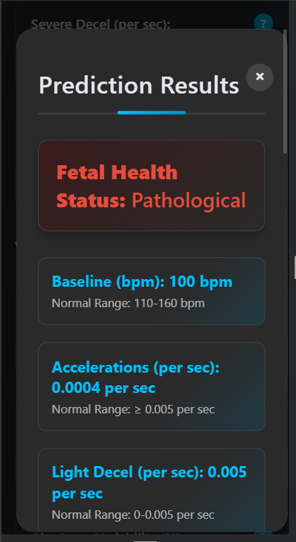
Fetal test Page(cont.)
Also It delivers immediate predictions of fetal health risks with guidance for consulting a specialist.
01

Slide 52
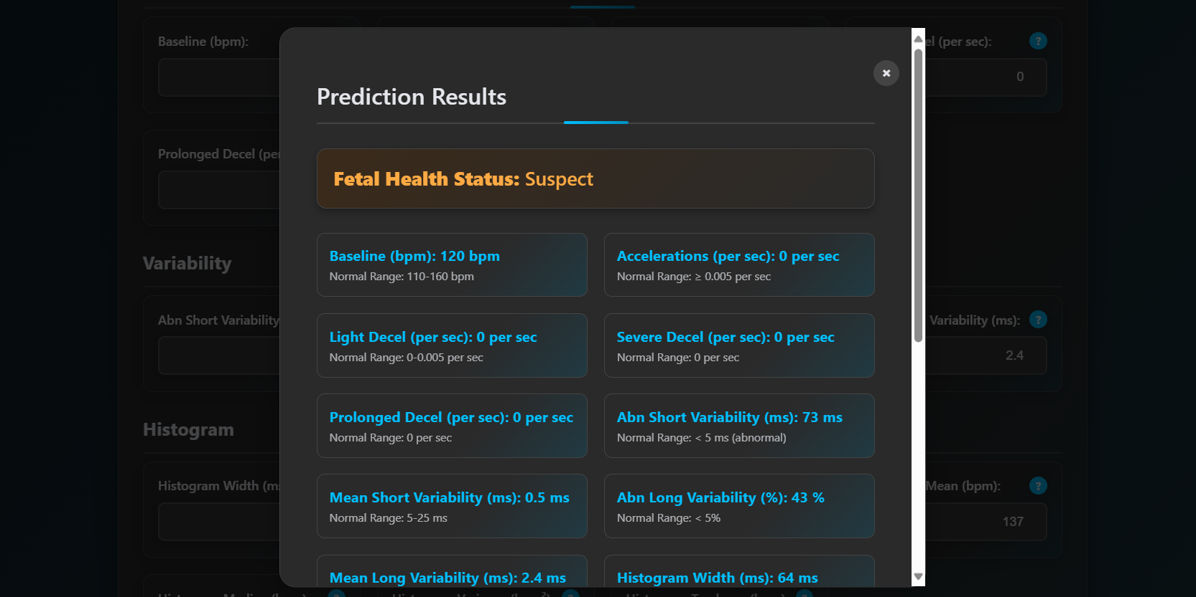
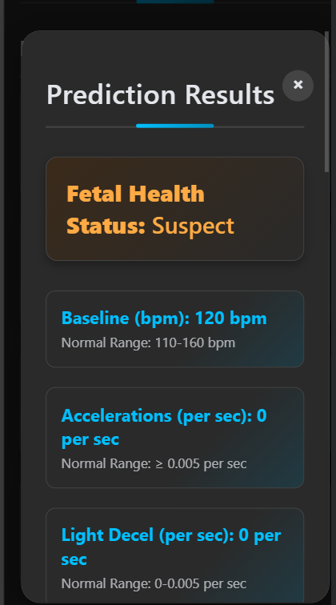
Fetal test Page(cont.)
01

Slide 53
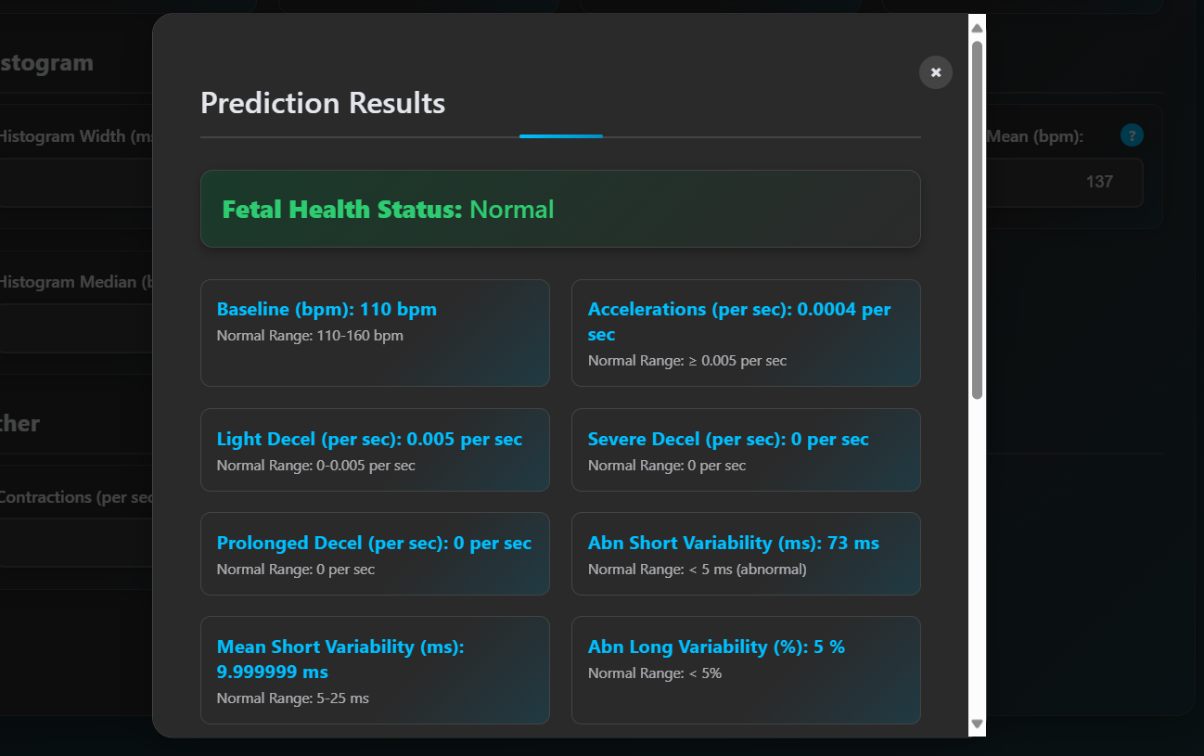
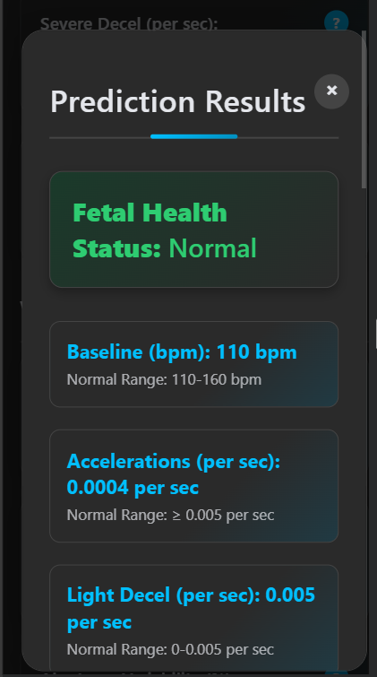
Fetal test Page(cont.)
01

Slide 54

Liver test Page
allows users to input biomarkers (e.g., liver enzyme levels) for analysis by AI models like Random Forest.
01

Slide 55


Liver test Page
It provides instant predictions of liver disease risk with recommendations for medical follow-up.
01

Slide 56


Liver test Page
01

Slide 57


Malaria test Page
enables users to upload blood smear images or input symptoms for analysis by AI models like YOLO and FastAI. It delivers immediate malaria detection results with confidence scores and specialist consultation guidance.
01

Slide 58
Research Objectives
To develop an intelligent, web-based healthcare platform that integrates AI and external medical APIs to assist users in performing preliminary disease diagnosis and accessing health education.
To analyze user-inputted symptoms and predict potential diseases using both external APIs (e.g., Priaid) and internally developed machine learning models.
To design and implement a machine learning-based disease classification model capable of accurately predicting conditions such as diabetes, heart disease, liver disease, malaria, and fetal health issues.
To link symptoms with relevant medical specialties in order to guide users toward appropriate specialist consultations.
To provide users with comprehensive information about potential diseases, enhancing health knowledge and supporting informed decision-making.

Slide 59
Research Objectives
6. To improve access to medical services by listing available doctors for online consultations, particularly in underserved or remote areas.
7. To implement secure user authentication and profile management features that support privacy, diagnosis history tracking, and personal health monitoring.
8. To evaluate the system’s effectiveness in promoting early diagnosis, supporting timely medical intervention, and improving healthcare consultation behavior.
9. To enhance user experience and usability through the development of a responsive, intuitive interface suitable for all user groups.
10. To generate visual health reports and statistics that help users monitor personal health trends and track diagnostic outcomes over time.

Slide 60

Time Plane

Slide 61



Code: AI models

Slide 62


Code: AI models

Slide 63


Code: API

Slide 64


Code: Database

Slide 65

DEMO:

Slide 66






Multilingual Support: Add Spanish, French, and Swahili via i18n frameworks to reach 30–50% more users
Wearable Integration: Incorporate Fitbit/Google Fit APIs to enhance ML predictions with real-time metrics
Telemedicine: Integrate WebRTC-based consultations with providers like Teladoc, increasing trust and retention
Future Work
To enhance TASHKHISI’s impact, future improvements include:
Mobile Application: Develop a React Native/Flutter app for offline capabilities, targeting 70% mobile users
Model Enhancement and Expansion: Use MLflow for automated retraining and extend disease coverage with new models (e.g., respiratory) using Kaggle/MIMIC-III datasets within 12–24 months.
Enhanced Visualization: Add Chart.js-based health trend charts, boosting engagement. These enhancements will broaden accessibility, improve diagnostic accuracy, and ensure scalability for global adoption.

Slide 67
Conclusion for Presentation
TASHKHISI represents a significant advancement in accessible healthcare, delivering a web-based platform that integrates symptom-based and AI-driven diagnostics to empower users in underserved regions. By combining Priaid’s API with ML models for malaria, diabetes, heart disease, liver disease, and fetal health, the system achieves 85–95% accuracy and response times competitive with commercial apps (1.2–6s). Its user-centric design, with secure authentication, personalized tracking, and WCAG 2.1 compliance, ensures usability across diverse demographics. The open-source, scalable architecture (Flask, MySQL, AWS) supports future growth, while GDPR-compliant data handling sets an ethical standard. By addressing gaps in existing tools like Ada and WebMD, TASHKHISI promotes early detection, health education, and equity, potentially reducing global healthcare costs and improving outcomes.

Slide 68
References
ApiMedic. (n.d.). Symptom Checker API. Retrieved June 9, 2025, from https://apimedic.com/
Flask. (n.d.). Flask documentation. Retrieved June 9, 2025, from https://flask.palletsprojects.com/
Howard, J., & Gugger, S. (2020). fastai: A layered API for deep learning. Information, 11(2), Article 108. https://doi.org/10.3390/info11020108
Joblib Developers. (n.d.). Joblib: Running Python functions as pipeline jobs. Retrieved June 9, 2025, from https://joblib.readthedocs.io/
NumPy Developers. (n.d.). NumPy. Retrieved June 9, 2025, from https://numpy.org/
OpenCV. (n.d.). OpenCV library. Retrieved June 9, 2025, from https://opencv.org/
Pandas Development Team. (2020). pandas-dev/pandas: Pandas. Zenodo. https://doi.org/10.5281/zenodo.3509134
Pedregosa, F., et al. (2011). Scikit-learn: Machine learning in Python. Journal of Machine Learning Research, 12, 2825–2830. https://jmlr.org/papers/v12/pedregosa11a.html
Pillow. (n.d.). Pillow (PIL Fork) documentation. Retrieved June 9, 2025, from https://pillow.readthedocs.io/
Priaid AG. (n.d.). Priaid Medical API documentation. Retrieved June 9, 2025, from https://developer.priaid.ch/
Python Software Foundation. (n.d.). Python language reference. Retrieved June 9, 2025, from https://www.python.org/
SQLAlchemy. (n.d.). SQLAlchemy documentation. Retrieved June 9, 2025, from https://www.sqlalchemy.org/
Ultralytics. (n.d.). YOLO object detection. Retrieved June 9, 2025, from https://docs.ultralytics.com/

Slide 69
Thanks

